Slide 1



Colistin resistance - what we found and why it matters
Professor Tim Walsh
Timothy R. Walsh

Slide 2
What is the pre-antibiotic Era?
Multi-drug Resistance (MDR)
e.g. NDM-1 (resistance to carbapenems)
Extensively-drug Resistance (XDR)
e.g. MCR-1 (resistance to polymixins/colistin)
Pan-drug Resistance (PDR)

Slide 3
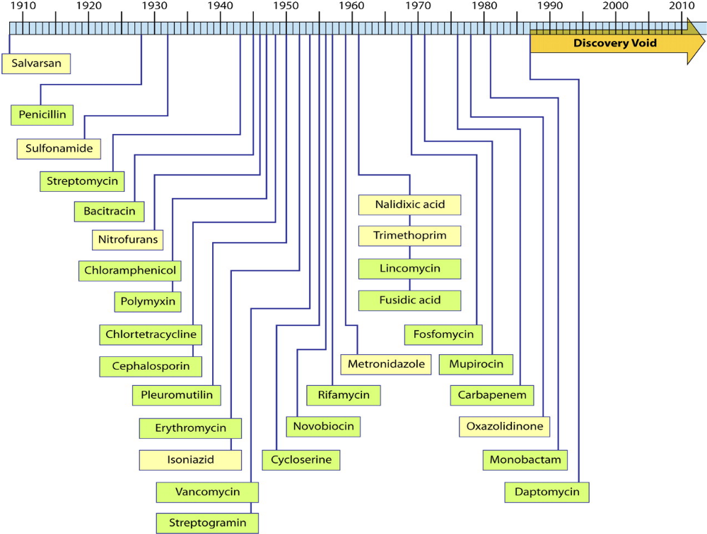

Slide 4
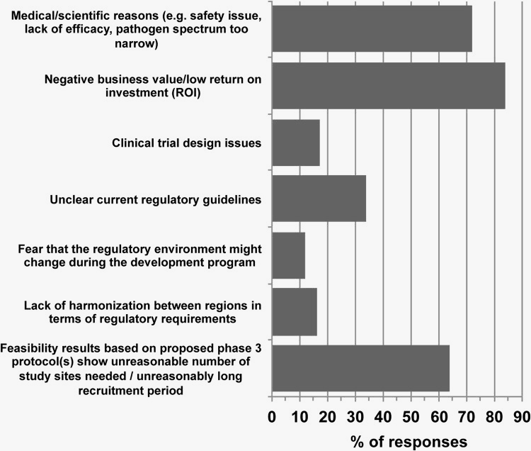
Bettiol et al., 2015. Antimicrob Agents Chemother. 59(7):3695-9.

Slide 5
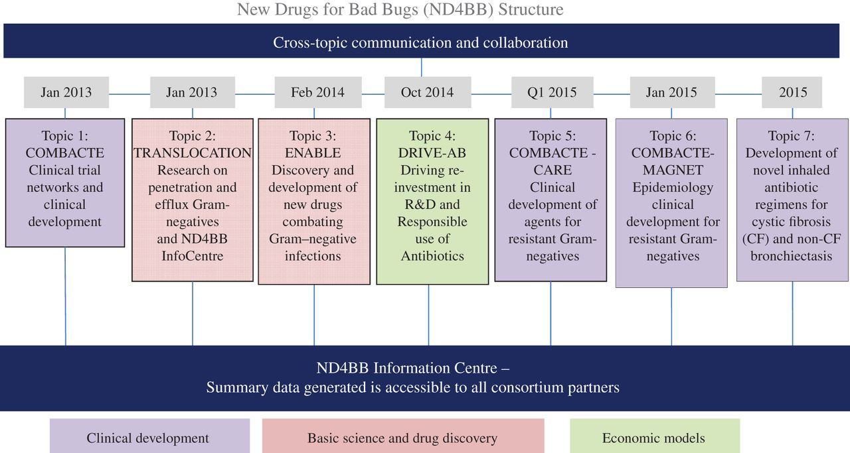

Slide 6
What is the pre-antibiotic Era?
Multi-drug Resistance
e.g. NDM-1 (resistance to carbapenems)
Extensively-drug Resistance
e.g. MCR-1 (resistance to polymixins/colistin)
Pan-drug Resistance

Slide 7
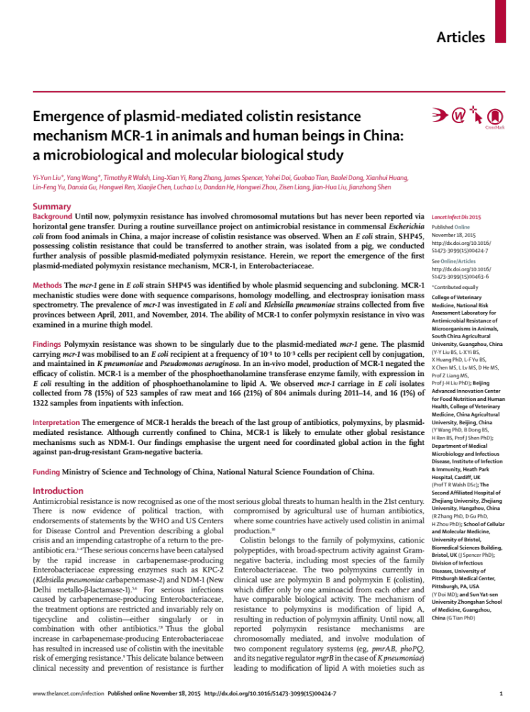

Slide 8
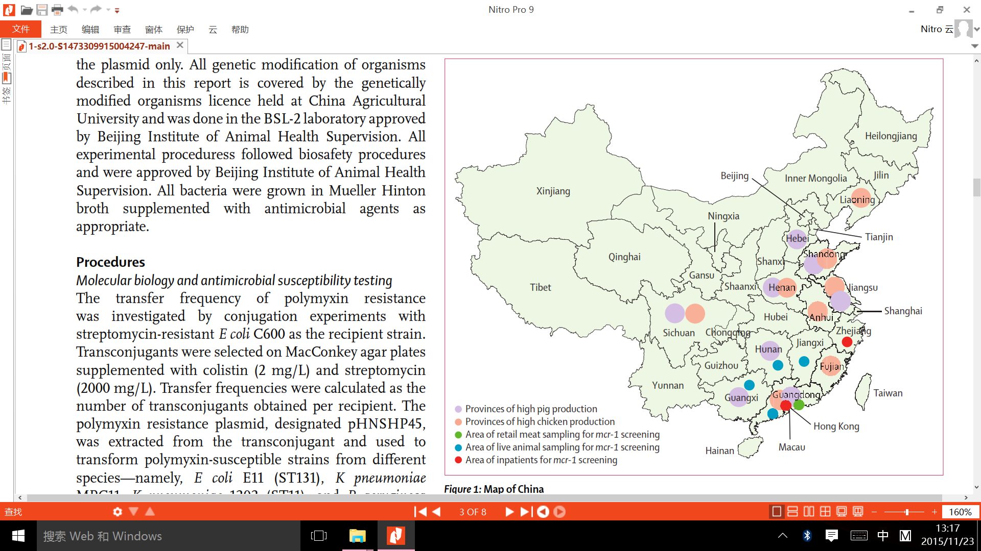

Slide 9
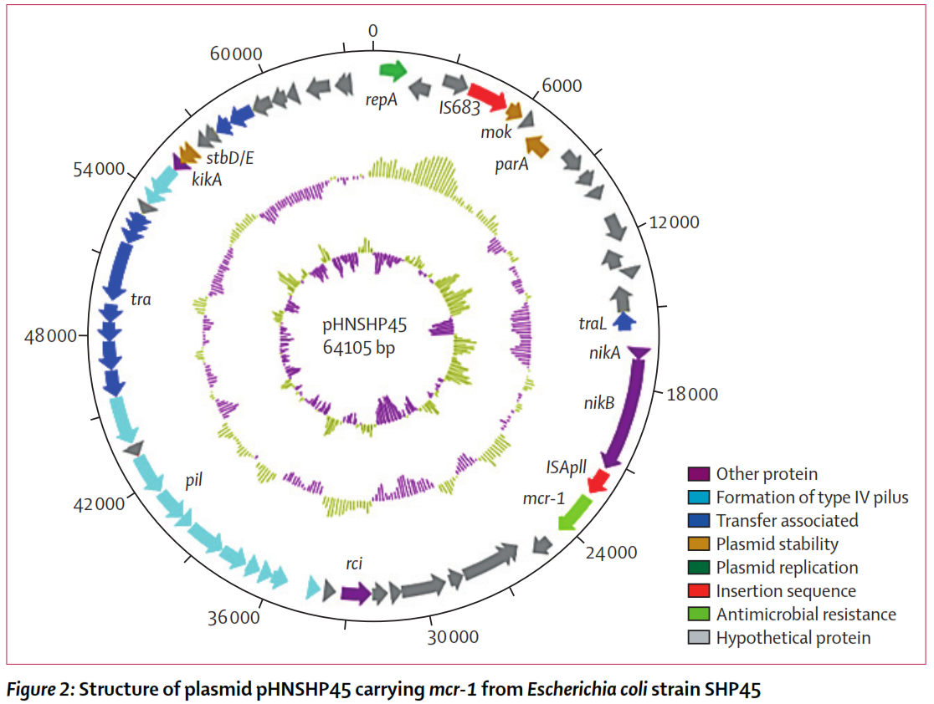

Slide 10
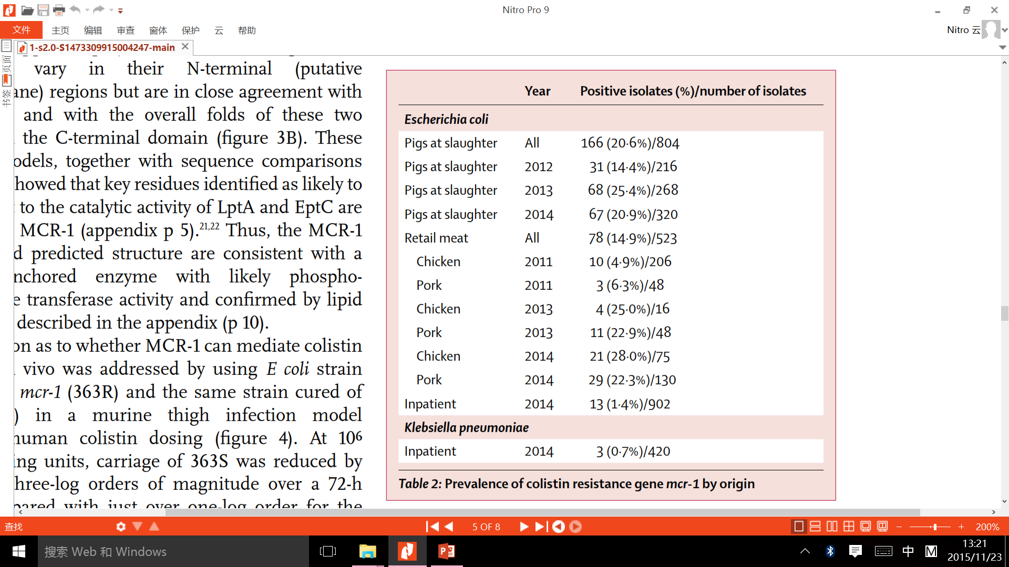
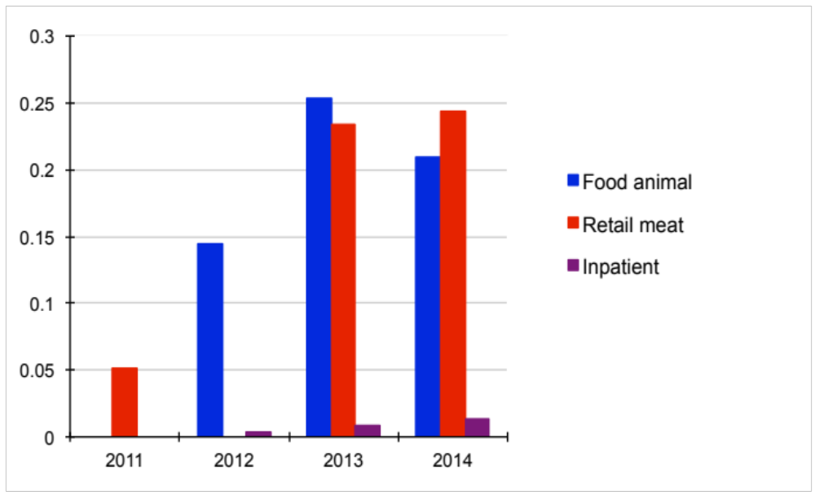
Food animal
Retail meat
Inpatients
30
25
20
15
10
5
0

Slide 11
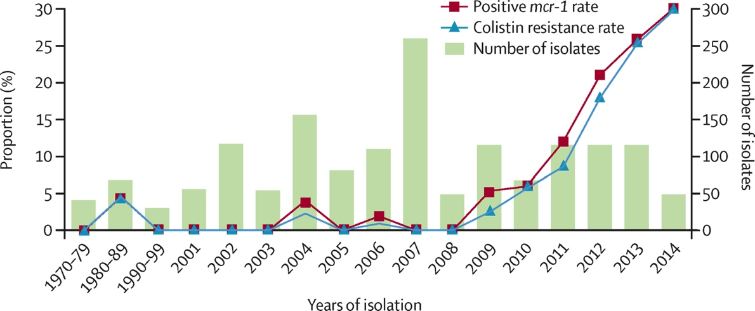
Shen et al., TLID. 2016

Slide 12
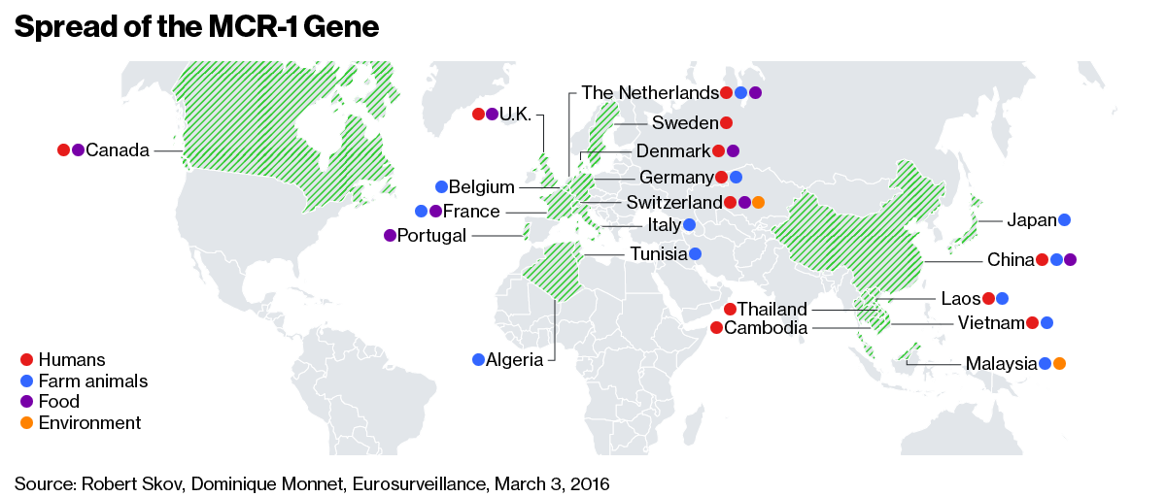
And now Spain – April 2016!

Slide 13
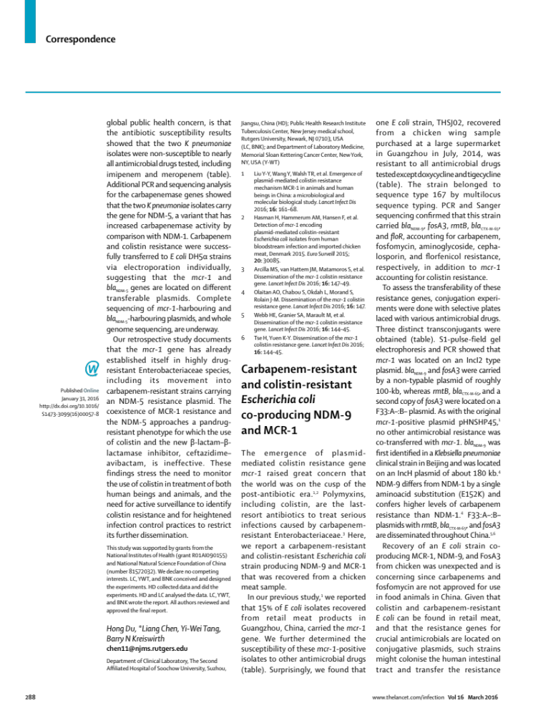
CRE with mrc-1

Slide 14
Why China?
China is the world’s largest poultry and pig producer and in 2014 produced 17.5 and 56.7 million tons, respectively (Chinese Ministry of Agriculture).
The global market value of veterinary drugs increased from $8.7 billion in 1992 to $20.1 billion in 2010 and in 2018 is anticipated to reach $43 billion.
The global demand for colistin in agriculture is expected to reach 11,942 tons per annum by the end of 2015 (with associated revenues of $229.5 million), rising to 16 500 tonnes by the year 2021

Slide 15
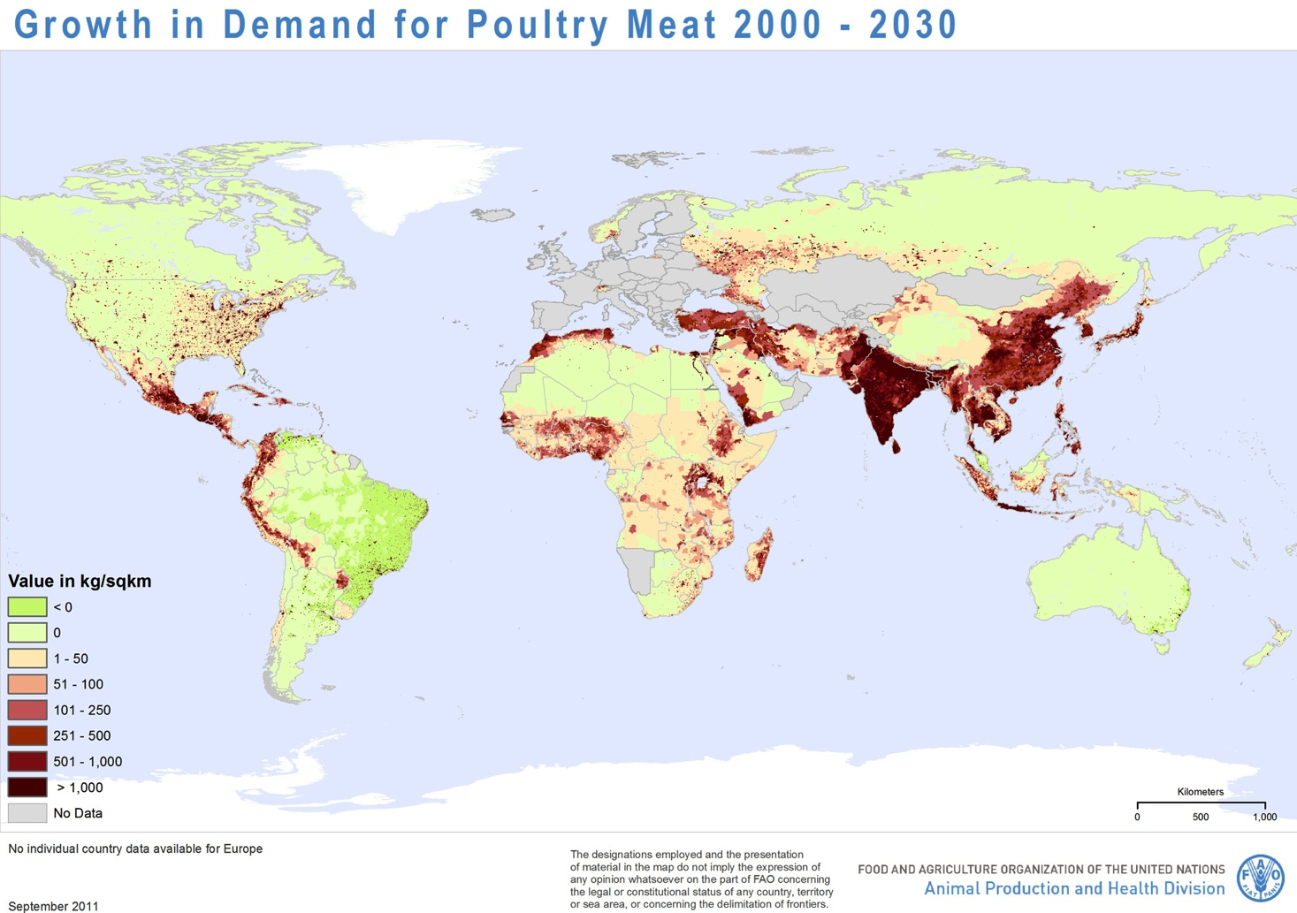

Slide 16
What now for China?
Rapid and Creative studies to understand the problem
Ministerial meetings in Beijing with MoA and MoH – November, 2015
Proposal for the total withdraw of colistin from food additives/growth promoters – April 2016
Explore exit strategies
Media – political/social damage limitation options

Slide 17
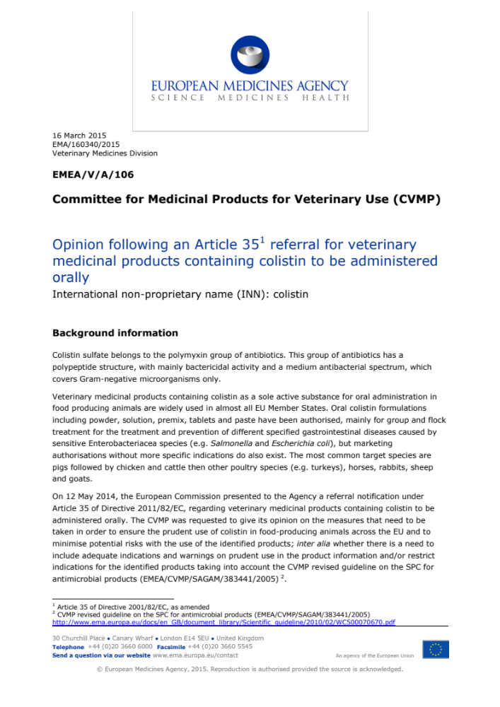
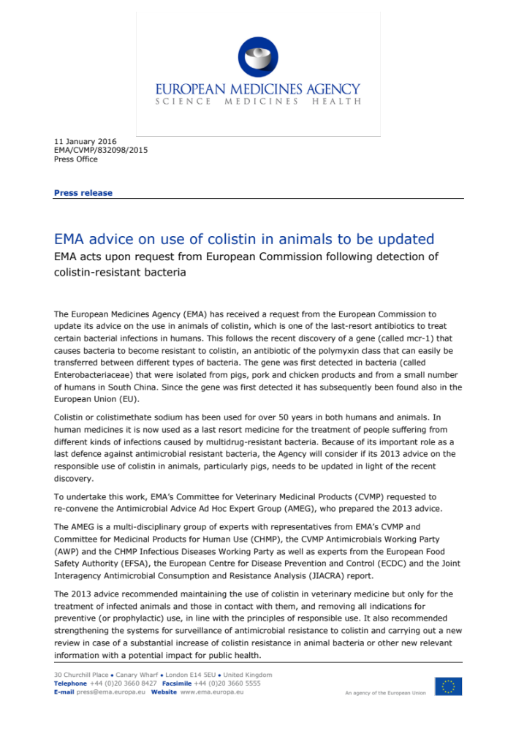

Slide 18



Acknowledgements

