Slide 1
Antibiotic stewardship in the UK dairy sector
Making farm animal practice work without critically important antimicrobials
Mr David Tisdall BVSc(hons) CertCHP FHEA MRCVS
Clinical Teaching Fellow in Farm Animal Science and Lead Farm Animal Clinician
School of Veterinary Sciences, University of Bristol

Slide 2


Slide 3




Notes:
~220 farm clients
~1500 dairy cattle (all conventional)
We do have a number of organic beef and sheep farms

Slide 4
Finding practical, partnership approaches that can achieve change towards more responsible and sustainable medicines use by farm vets, farmers and future vets.
Herd health management
Clinical governance
Undergraduate teaching
Notes:
Farm level, practice level and future practitioners

Slide 5
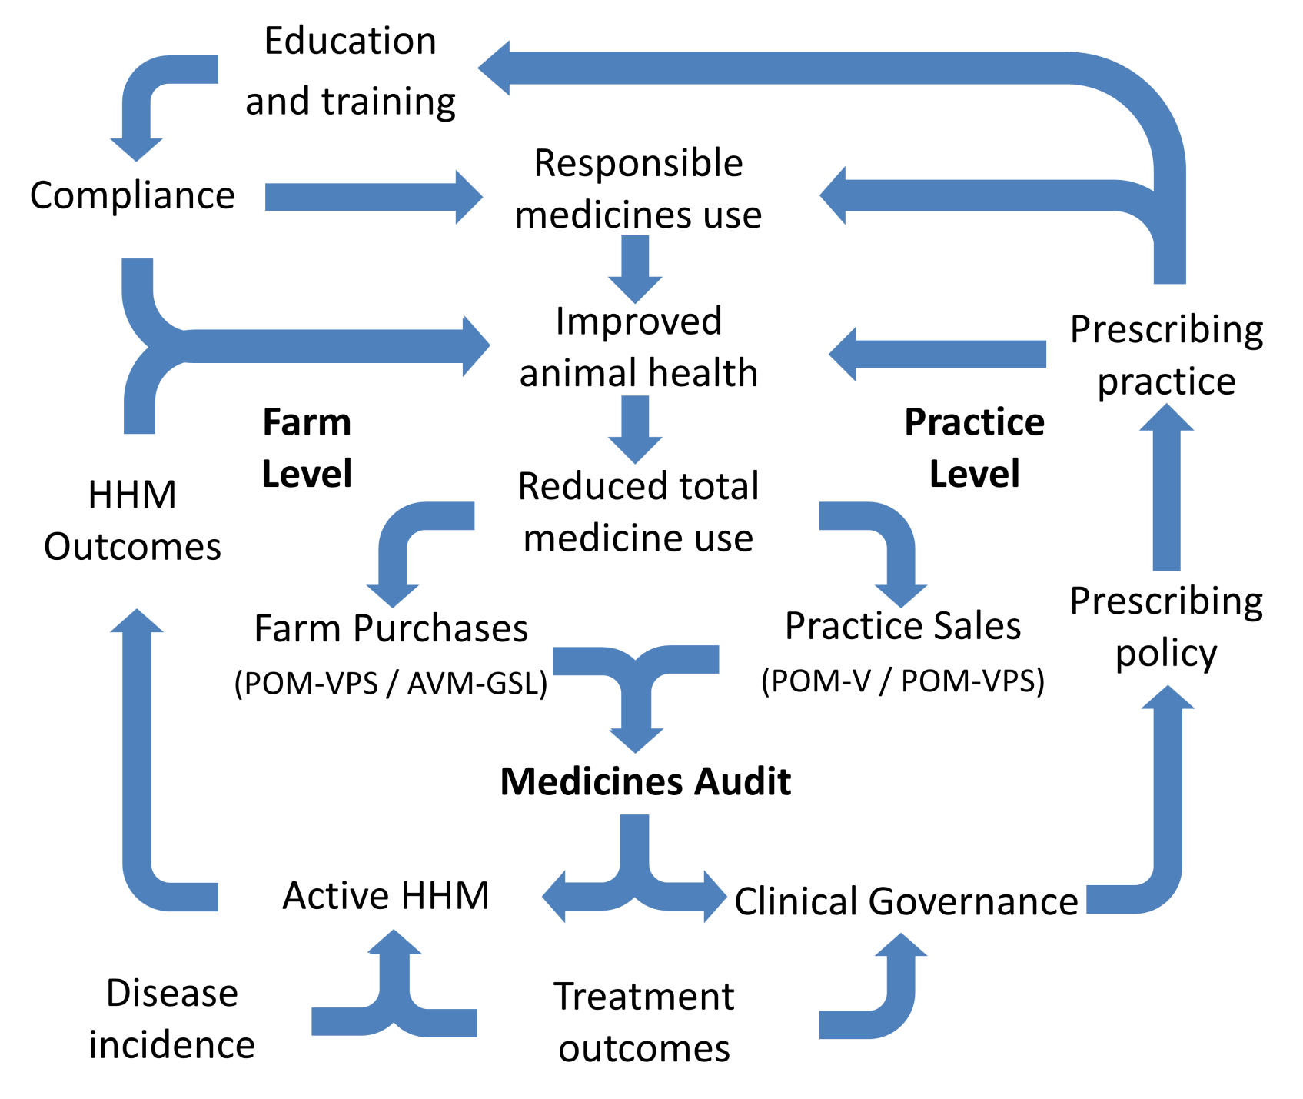
Why does farm medicines use matter?
One health¹
  Animal health
  Human health
  Environment
Economics and politics
Antimicrobial use
  Stewardship
  AMR
  CIAs
¹ONE HEALTH INITIATIVE. 2014. One Health Initiative [Online]. Available: http://www.onehealthinitiative.com/index.php [Accessed 21/08/2014 2014].
.

Slide 6
Antimicrobial resistance (AMR)
A paradox:
  Increasing public and scientific concern about the potential transfer of AMR from animals to people¹
  The main driver of AMR in people remains the use of antimicrobials in human medicine²
This doesn’t mean that veterinary use is unimportant.
¹SEIFFERT, S. N., HILTY, M., PERRETEN, V. & ENDIMIANI, A. 2013. Extended-spectrum cephalosporin-resistant Gram-negative organisms in livestock: an emerging problem for human health? Drug Resist Update, 16, 22-45.
²DEPARTMENT OF HEALTH 2013. UK Five Year Antimicrobial Resistance Strategy 2013 to 2018. London: Department of Health.
.

Slide 7
Critically important antimicrobials (CIAs)
What makes an antimicrobial critically important for human medicine (WHO)
  Agents that are the sole or a limited number of substances available as therapy for serious human disease .
  Pathogens which are zoonotic or where there exists the potential for resistance gene transfer from non-human sources.
These are commonly used in farm animal practice
WORLD HEALTH ORGANISATION 2012. Critically important antimicrobials for human medicine 3rd Revision 2011. 3 ed. 20 Avenue Appia, 1211 Geneva 27, Switzerland: WHO Press, World Health Organisation.

Slide 8
CIAs currently licensed for use in food producing animals in the UK.
Class |  | Farm animal veterinary examples
Cephalosporins | Third gen | Ceftiofur, Cefoperazone
 | Fourth gen | Cefquinome
Fluoroquinolones |  | Danofloxacin, Enrofloxacin, Marbofloxacin
Macrolides |  | Gamithromycin, Tildipirosin Tilmicosin, Tulathromycin, Tylosin
Aminoglycosides |  | Dihydrostreptamycin, Framycetin, Kanamycin, Neomycin, Streptomycin,
Penicillins |  | Ampicillin, Amoxycillin, Penicillin G, Penethamate hydroiodide

Slide 9
What’s the solution and who’s responsible?
DEPARTMENT OF HEALTH 2013. UK Five Year Antimicrobial Resistance Strategy 2013 to 2018. London: Department of Health.

Slide 10
What’s the solution?
Department of health 2013
Reducing total use while driving more responsible use on farms – optimising antimicrobial use – is likely to have the biggest impact in slowing AMR development
DEPARTMENT OF HEALTH 2013. UK Five Year Antimicrobial Resistance Strategy 2013 to 2018. London: Department of Health.

Slide 11
Who’s responsible?
Vets are the gatekeepers (all antimicrobials are POM-V)
  Clinical assessment
  Diagnosis
  Prescription
Even though animal keepers are often the main users
  Partial compliance is a common (Sawant et al., 2005)
SAWANT, A. A., SORDILLO, L. M. & JAYARAO, B. M. 2005. A Survey on Antibiotic Usage in Dairy Herds in Pennsylvania. Journal of Dairy Science, 88, 2991-2999.

Slide 12
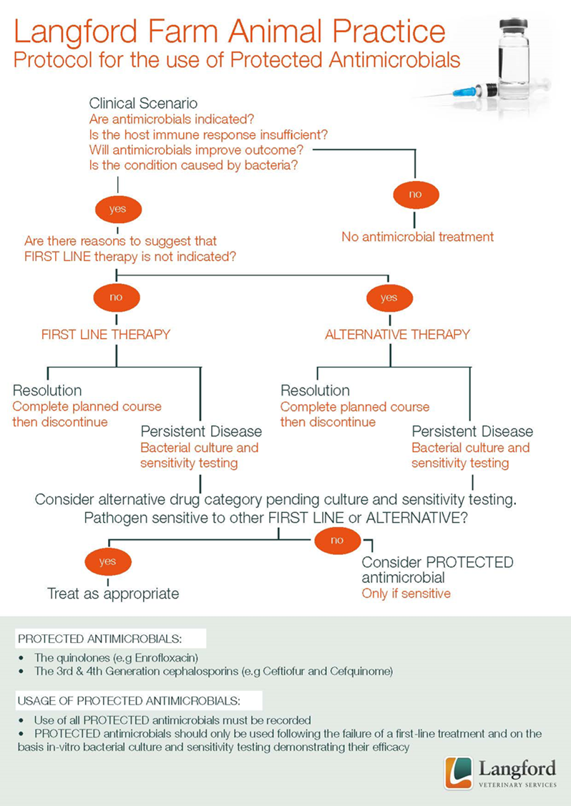
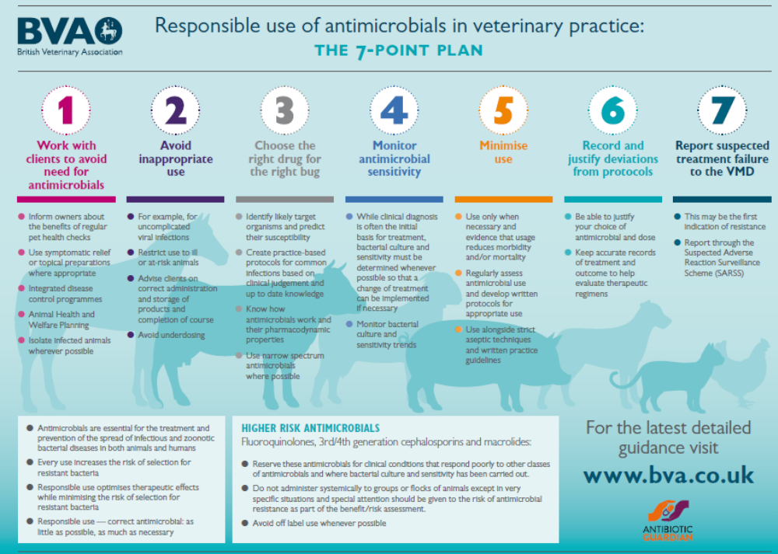
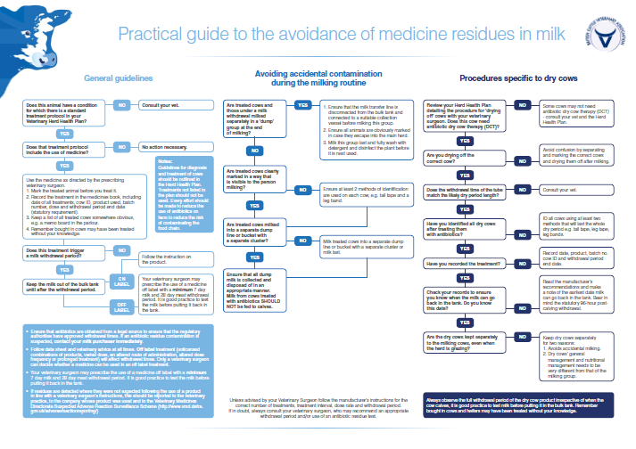
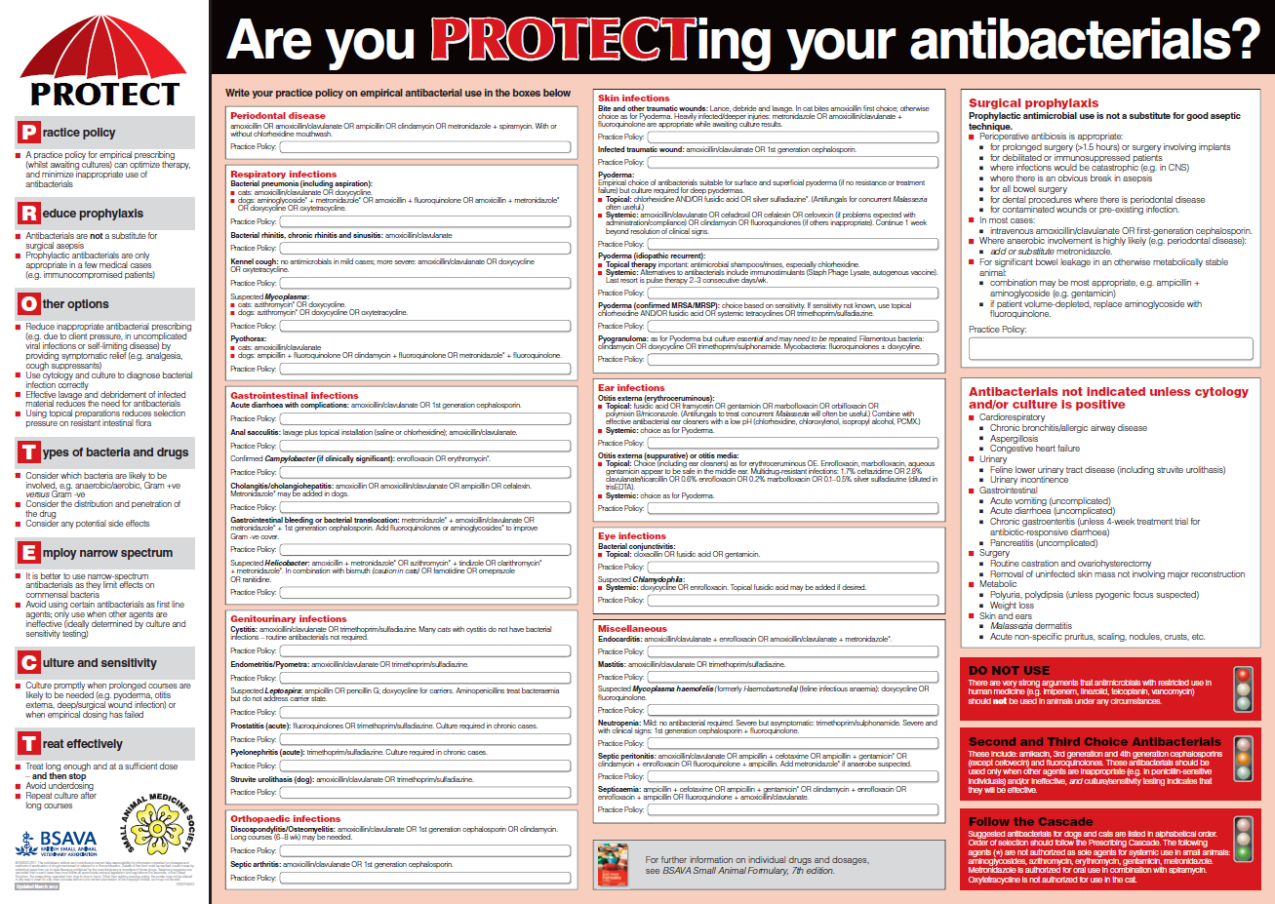

Slide 13
Responsible medicines use
Welfare
Reproductive health
Udder health
Herd health management
Nutrition
Mobility
Youngstock health
Metabolic health
Production
Notes:
Use of intrauterine Abs, Hormones etc
LCT and DCT use, including SDCT
NSAID use
Calcium, glycerol, ketosaid etc
Vaccination use
Antipneumonials
NSAIDs and level of disease

Slide 14

Approach
Practice-wide
Collaborative and participatory
Multifaceted
  Changes to herd health management (HHM)
  Changes to prescribing policy
  Systematic medicines audits
  Farmer training on compliance and responsible use.

Slide 15
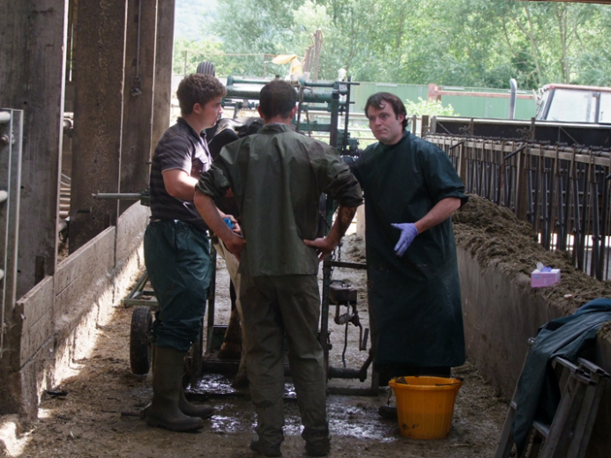
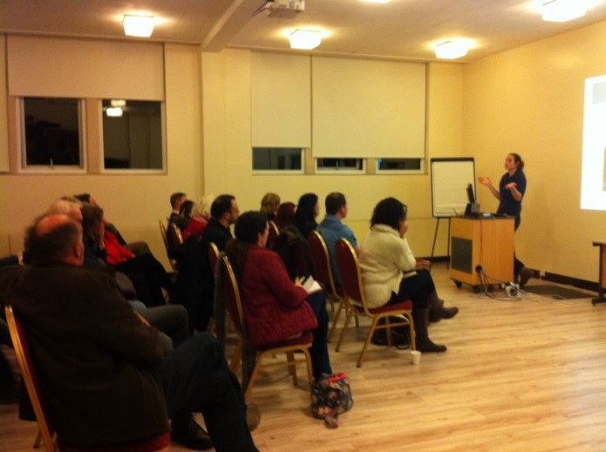
2012
Farmer workshops
Changed prescribing policy for CIAs
Scoping options for medicines audits
2011
First-line treatments
Focussed reduction of use of 3rd/4th gen cephalosporins
The beginning …
Active HHM
Building partnerships
First-line treatments
Halted quinolone use
Notes:
Changing order
No pre
Changes
Workshops for farmers

Slide 16
Major changes in prescribing policy
Fluoroquinolone use stopped
Intramammary use
  4th gen cephs phased out in favour of penicillins and aminoglycoside combinations
Systemic use
  3rd gen cephs substituted with 1st gen or aminopenicillins.
Calf pneumonia
  Treated with oxytetracycline or florfenicol, replacing the longer-acting macrolides.

Slide 17
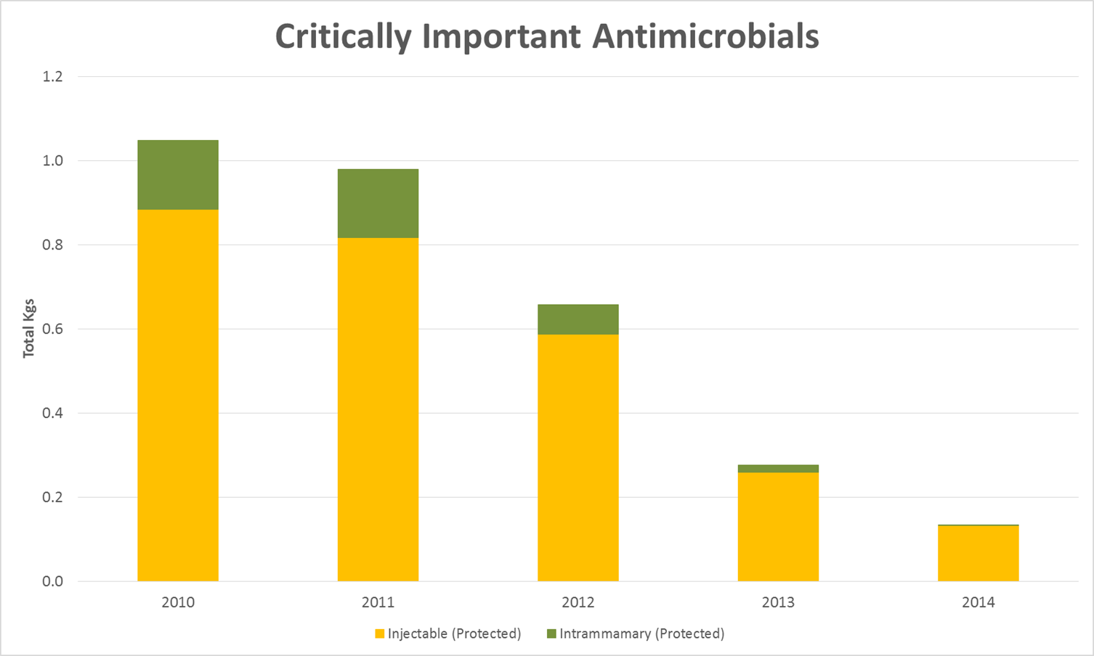


2015
Third round of medicines audits*
2014
Farmers meetings
Progress update
Medicines auditing tool refinement
Second round of medicines audits*
2013
Farmers meetings
Medicines auditing tool development
First round of medicines audits*
Integration into herd health management
* Integrated into farm animal elective teaching
Notes:
Medicines auditing tool
Graph screenshot

Slide 19
What to measure?
Animal health and welfare
  Preventative interventions Vs reactive treatments
  Reduction in total medicines use
  Shifting the balance (e.g. NSAIDs and TS)
Responsible medicine use
  As little as possible but as much as necessary
  Strategic use
  Appropriate preventative use (e.g. DCT)

Slide 20
What to measure?
Farm level
  Animal daily doses
  Courses per animal year at risk
  Economic measures (e.g. PPL)
Practice level
  Total Mgs

Slide 21
Challenges
Uncertain population demographics
  Numbers, type and bodyweight
  Herd size (Average Vs fixed point of time)
Assumptions on medicines use
  Course length, dose etc
  Condition under treatment
Complexities of interpreting measures of medicines use

Slide 22
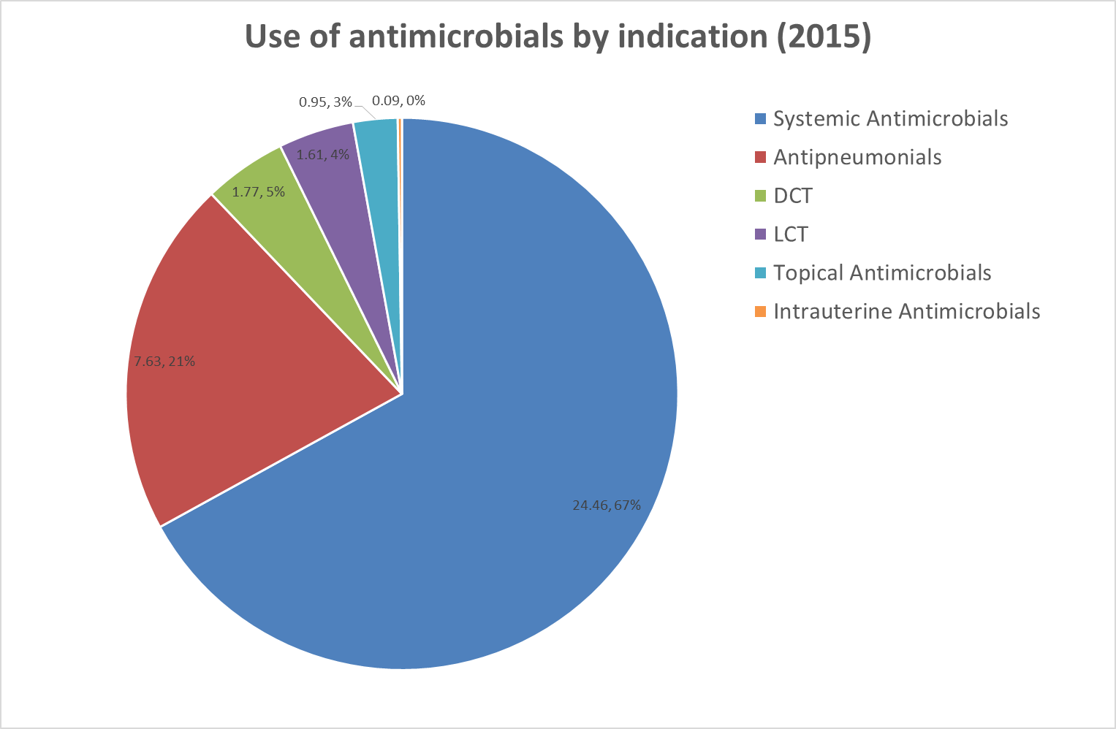
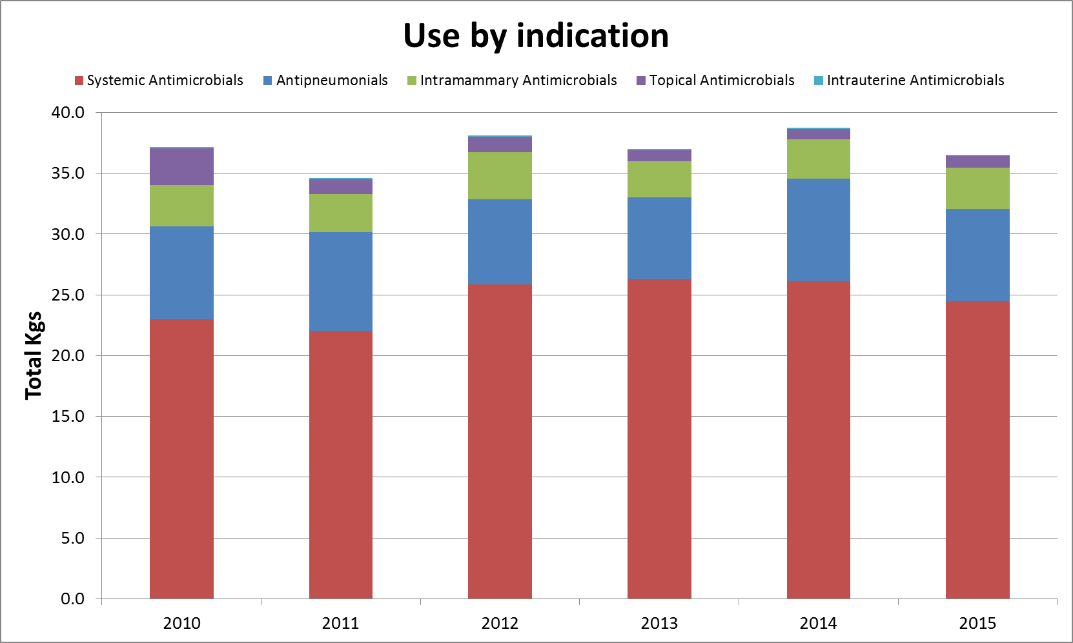

Slide 23
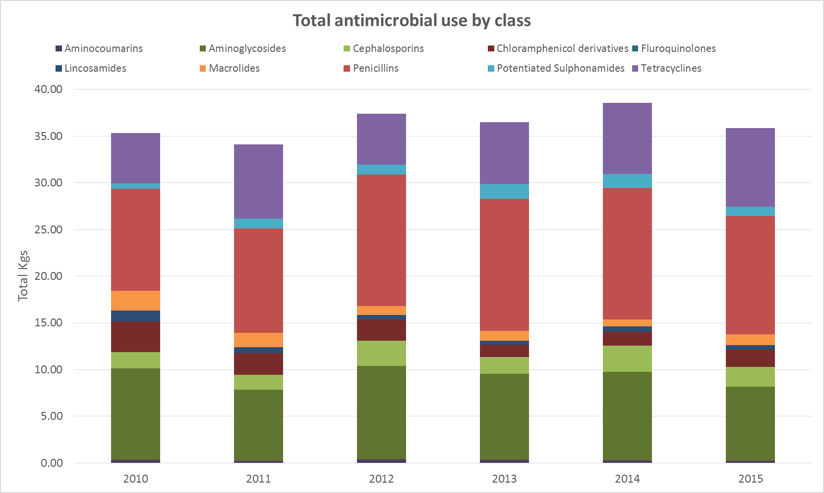
7% reduction in total antimicrobial use compared to 2015
Approximately a 10% increase in dairy cattle compared to 2010

Slide 24
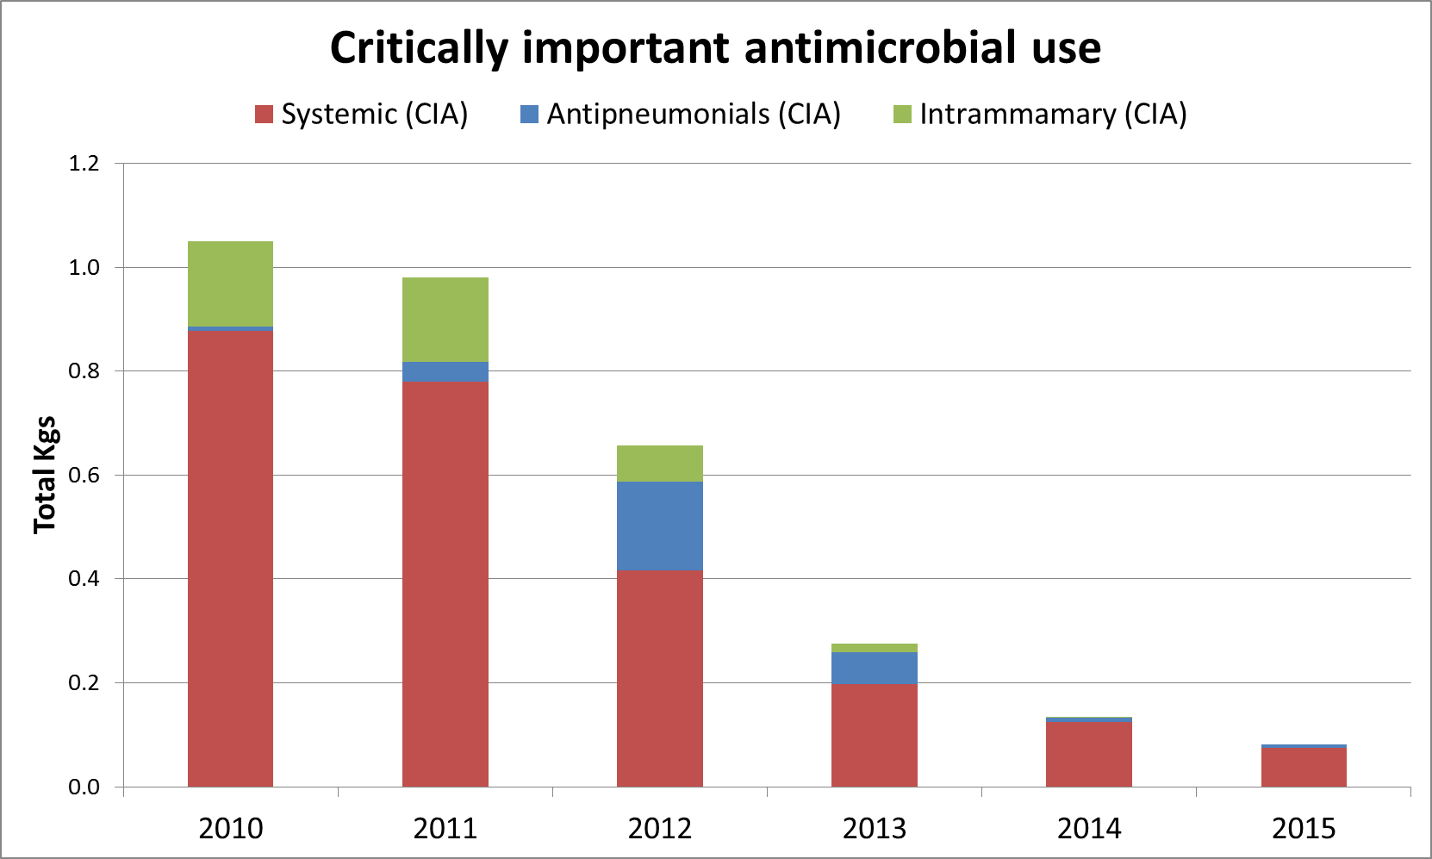
82% reduction in the total use of CIAs
No perceived or actual reduction in treatment outcomes or farm animal health
91% reduction in systemic use of CIAs
100% reduction in intra-mammary use of CIAs

Slide 25
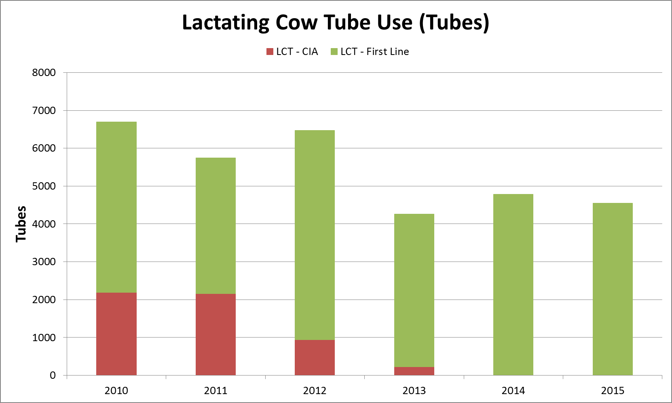
32% reduction in LCT use compared to 2010
100% reduction in the use of CIA’s in LCTs compared to 2010

Slide 26
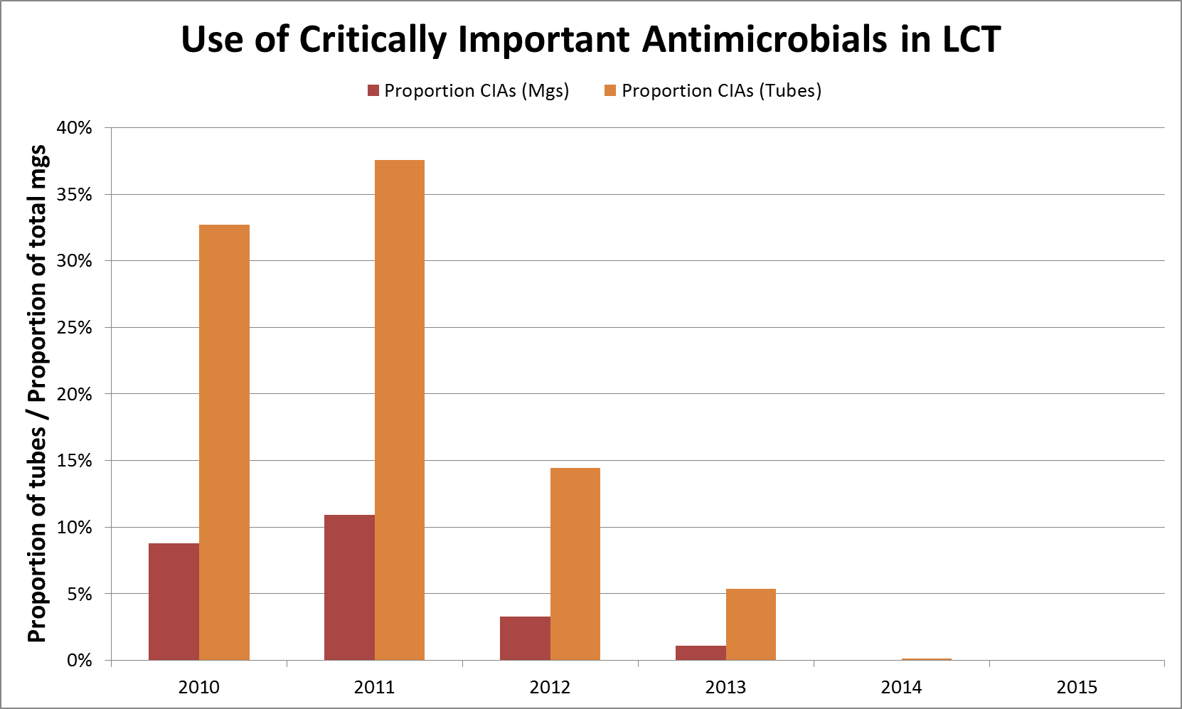
2010:
> 35% LCTs involved CIAs (~10%mgs)
2015:
0% of LCTs involved CIAs (<0%mgs)

Slide 27
The challenge of interpretation
10% increase in dairy cattle numbers
Training on accurate dosing and course completion
Higher dose rates of first line antimicrobials
(e.g. the dose rate of amoxicillin is 7 mg/kg compared to 1mg/kg for ceftiofur).
Reduced incidence of diseases requiring antimicrobial therapy (consistent with farm level data)

Slide 28
Results
Farm clients have been consistently positive about tackling the issues of responsible medicines use and AMR in partnership with the practice.
Informal feedback suggests farmers have found measures which express antimicrobial use in terms of doses, courses or economics most useful.

Slide 29
Why has this approach been a success?
Partnership: participatory and collaborative
Involving the whole practice team
Integrating medicines use into HHM
Improved herd health and welfare
Notes:
Cooperation rather than confrontation (though this doesn’t mean practice are not challenged)
Opportunities to increase the use of certain categories may be identified
Particular insight into Youngstock disease and worming strategies which is often not well recorded.
Change the title

Slide 30
Potential impact on AMR
Potential reduction in selection pressure for ESBLs.
  On dairy farms, recent use of 3rd / 4th gen Cephs is strongly associated with an increased likelihood of the presence of ESBL E. coli (specifically CTX-M), while use of 1st / 2nd gen cephs is not¹.
Reduced antimicrobials courses per animal per year.
¹SNOW, L. C., WARNER, R. G., CHENEY, T., WEARING, H., STOKES, M., HARRIS, K., TEALE, C. J. & COLDHAM, N. G. 2012. Risk factors associated with extended spectrum beta-lactamase Escherichia coli (CTX-M) on dairy farms in North West England and North Wales. Prev Vet Med, 106, 225-34.

Slide 31
Conclusions
It is possible to achieve marked reductions in the quantity of protected antimicrobials used whilst…
  Keeping farmers on board
  Continuing to improve animal health and welfare
… and without the need for legislation.
The use of CIAs as first line treatments cannot be justified.

Slide 32
Conclusions
Monitoring use is an essential part of good antimicrobial stewardship
  This must include treatment outcomes
Medicines auditing goes hand in hand with improved HHM
Picking the right measures matters
Working in partnership works
Getting the message out there

Slide 33
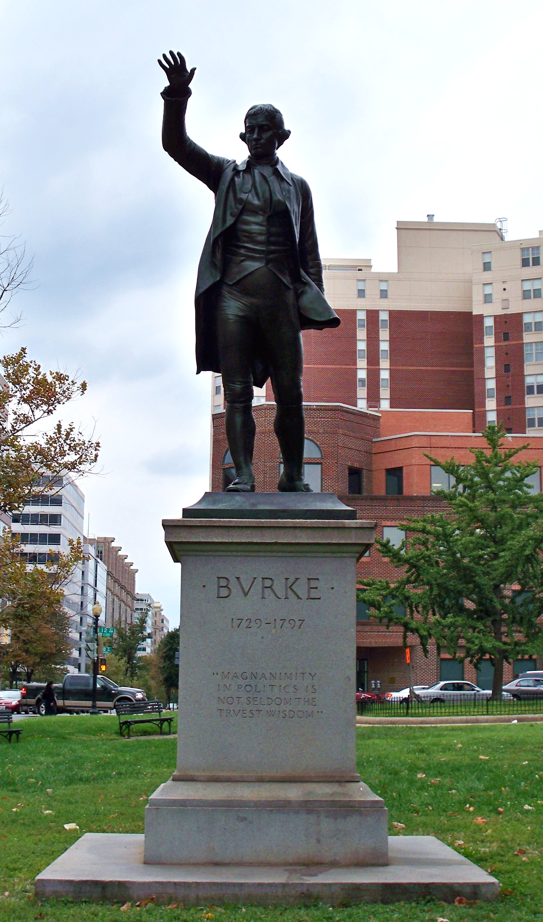
“Nobody made a greater mistake than he who did nothing because he could only do a little!”
Edmund Burke (1729 – 1797)
Notes:
Anglo-irish politician and philosopher. Statue of him in Washington DC.

Slide 34

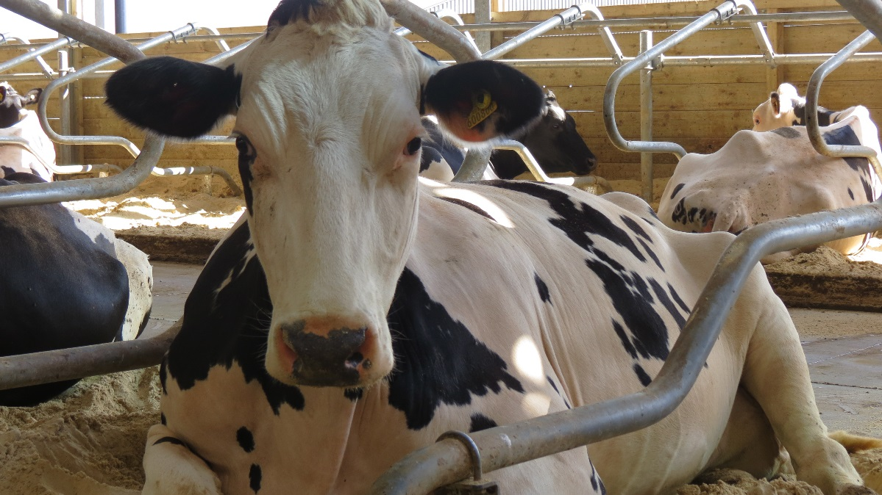
Thank you for listening
Acknowledgements
  University of Bristol farm animal group
  Langford farm animal practice clients and colleagues
  Final year veterinary undergraduates undertaking the farm animal elective

