Slide 1

Responsible use
- the veterinary perspective
John M Blackwell BVSc MRCVS
BVA Senior Vice President
ASOA Conference April 2015

Slide 2
Objectives
What do we understand by resistance to antimicrobials
What are the concerns and why
What is the evidence base implicating Animal Health
What can we do
What do we need
How do we measure success
?

Slide 3
The problem
Since commercial production in 1940s scientists predicted that antimicrobials would defeat the infectious diseases that had plagued mankind … but these remarkable drugs led to widespread and often inappropriate use.
Resistance is the ability of the bacteria to withstand the action of the drug. This is a natural phenomenon and resistance can be shared within and between bacterial species.

Slide 4
The WHO’s first global report on Antimicrobial Resistance (2014) with a focus on Antibiotic Resistance, reveals it is no longer a prediction for the future:
“When bacteria change so antibiotics no longer work in people who need them to treat infections – is now a major threat to public health … the world is headed for a post-antibiotic era, in which common infections and minor injuries which have been treatable for decades can once again kill”
CMO Professor Dame Sally Davies said:
“ Antimicrobial resistance poses a catastrophic threat. If we don’t act now any one of us could go into hospital in 20 years for minor surgery and die because of an ordinary infection which cant be treated by antibiotics”

Slide 5
UK 5 Year Antimicrobial Strategy 2013-2018
Sets out action to limit resistance development and conserve
Main driver: Human medicine
Recognises : Multidisciplinary approach, Human ( including dental) and Animal Health
Global
Stakeholders: Defra, VMD, NHS, PHE, Scottish Government, Welsh Government, NI Exec.

Slide 6
Three Strategic Aims:
Improve the knowledge and understanding of AMR
Conserve and steward the effectiveness of existing treatments
Stimulate the development of new antibiotics, diagnostics and novel therapies
… A Global “One Health” Approach

Slide 7
“Increasing scientific evidence suggests that the clinical issues with antimicrobial resistance that we face in human medicine are primarily the result of antibiotic use in people, rather than the use of antibiotics in animals.
“Nevertheless, use of antibiotics in animals (which includes fish, birds, bees and reptiles) is an important factor contributing to the wider pool of resistance which may have long term consequences.”

Slide 8
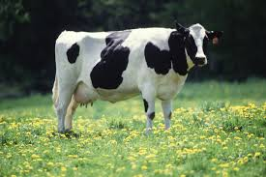
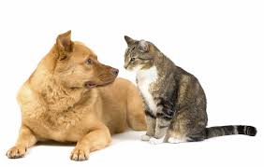
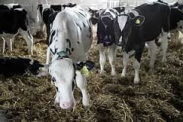
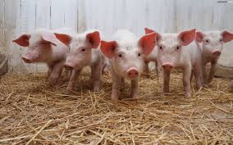
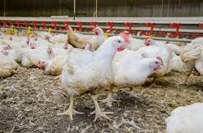
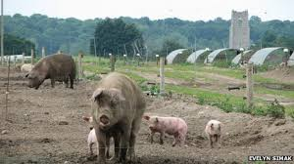
How do we use antibiotics in animals
  Animals suffer from infectious bacterial diseases which must be treated.
  1. Curative Treatment or Therapy
  Treatment of a sick animal or group of animals following the diagnosis of infection and clinical disease

Slide 9
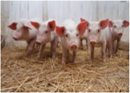

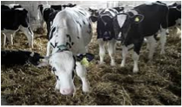
How do we use antibiotics in animals?
  2. Control treatment - sometimes called Metaphylaxis
  (Prophylaxis in human medicine)
  Treatment of a group of animals following the diagnosis of infection and clinical disease in part of the group, with the aim of preventing the spread of infectious disease to animals in close contact and at considerable risk and which may already be (sub-clinically infected)

Slide 10
How do we use antibiotics in animals?
3. Preventive treatment sometimes referred to as prophylaxis – Treatment of an animal or groups of animals before clinical signs of infectious disease, exceptionally in order to prevent the occurrence of disease or infection
  Must only be applied to animals diagnosed at high risk of bacterial disease
  Must not be used to compensate for poor hygiene or inadequate husbandry conditions or where improvements in animal husbandry could reduce the need for antibiotic use. May be used on a temporary basis to prevent disease while vet and farmer improve bio-security and animal husbandry on farm
  Must only occur under the prescription of a veterinarian
  Must not be applied systematically or routinely

Slide 11
From the veterinary perspective, what is the problem?
Many of the veterinary pathogens are still susceptible
There is some evidence of resistance emerging in some organisms
Real concern about zoonotic bacteria causing disease in man
  Salmonella – Campylobacter - Some strains of E coli -Livestock associated MRSA
Also concerns regarding commensals in animals
  E Coli (exact relationships to those isolates in man not determined)
  Enterococci
Reverse zoonoses
MRSA in companion animals

Slide 12
What is the veterinary profession doing about it?
Lobbying hard against bad law which does not solve the problem and may contribute to it
Challenging misconceptions about the causes of resistance
Arguing for management of resistance to be based on sound scientific risk assessment and not wholly on the precautionary principle
Promoting stricter conditions for the use of certain categories of antimicrobials, which have special importance in human medicine (e.g. fluoroquinolones and 3rd-4th generation of cephalosporins)
Striving for better animal health management on farm to reduce the need for antimicrobials
Reinforcing the message and campaigning to raise awareness of the crucial importance of evidence based responsible use supported by appropriate guidelines, and possibly “regulation”

Slide 13
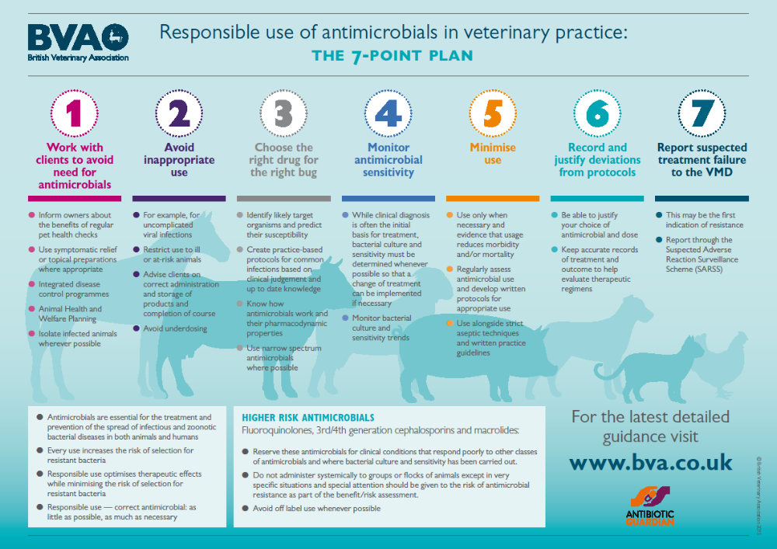
Notes:
Provision of member resources vet focused as with this as yet still at the printers recently revised responsible use poster for display within the practice. To trigger the thought process the reasoning behind responsible prescribing and use

Slide 14
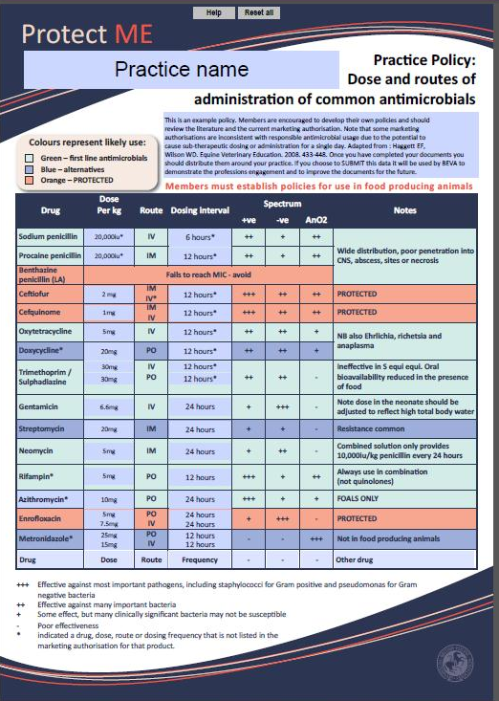
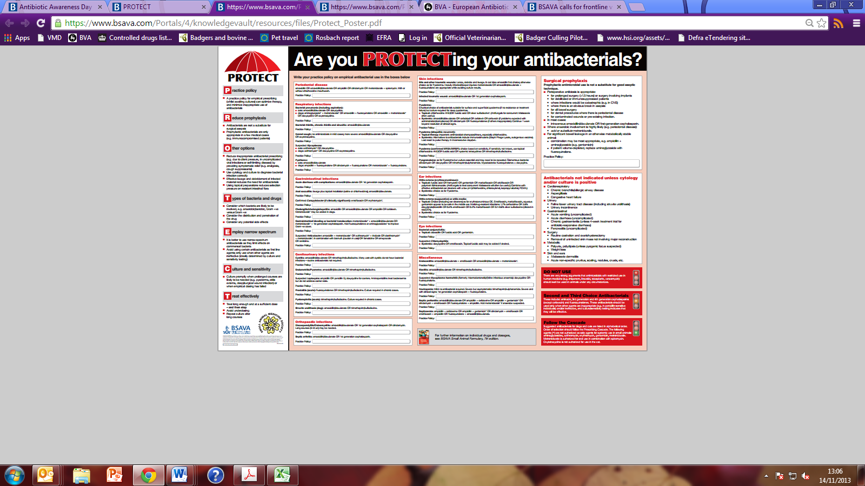

Pig Veterinary Society

Slide 15
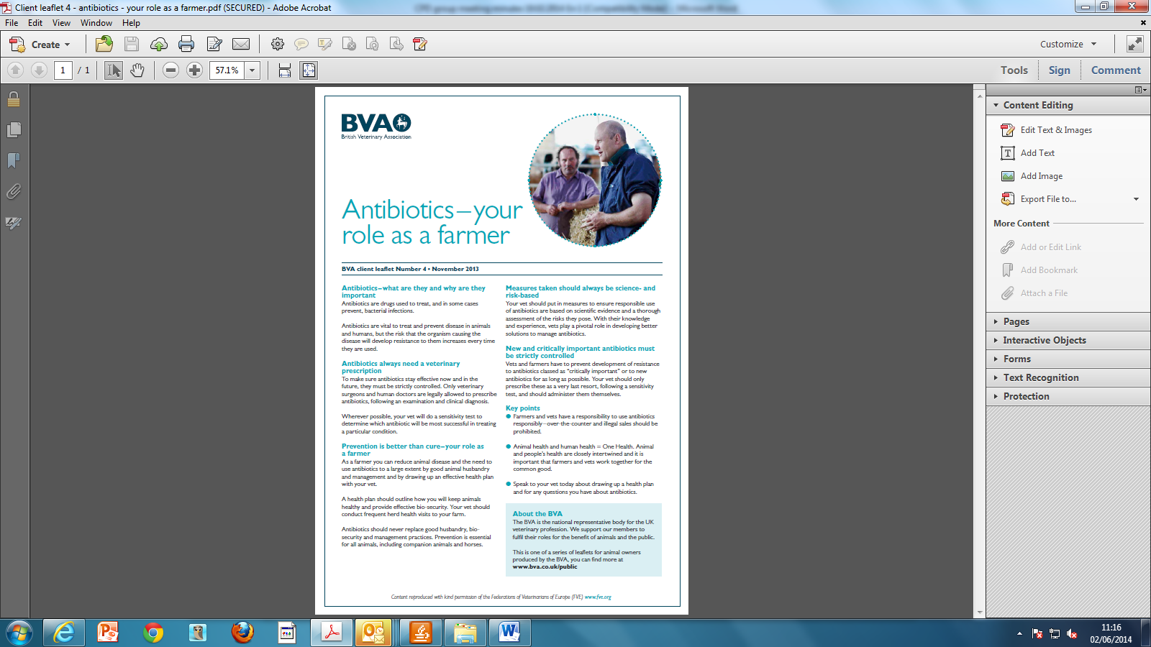
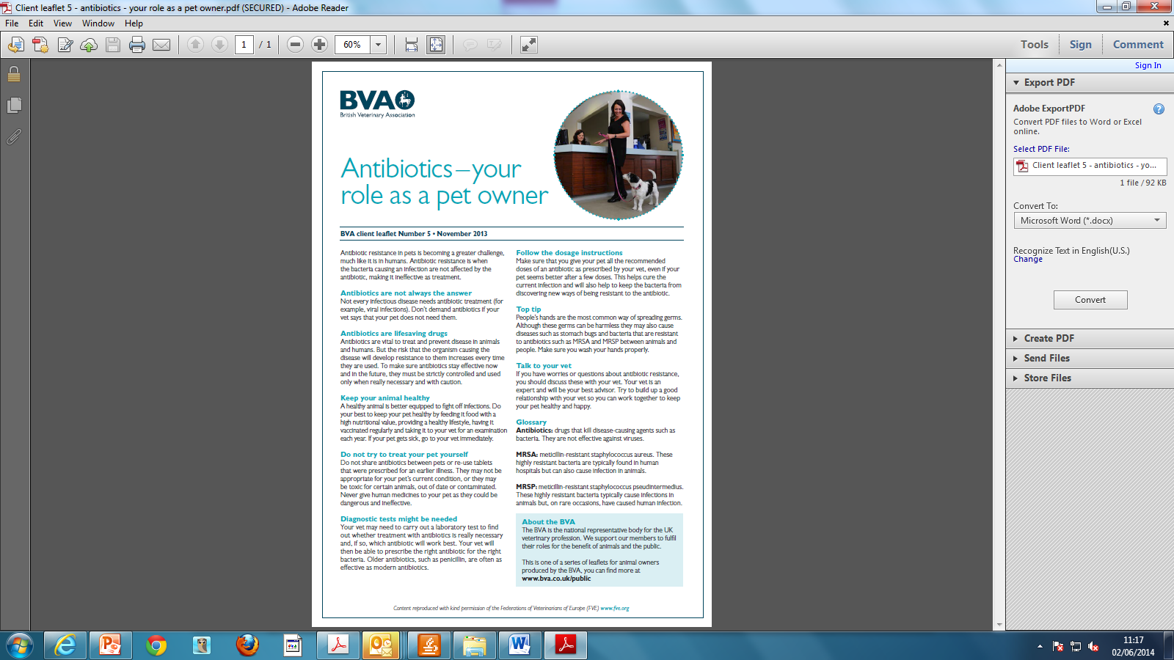

Slide 16
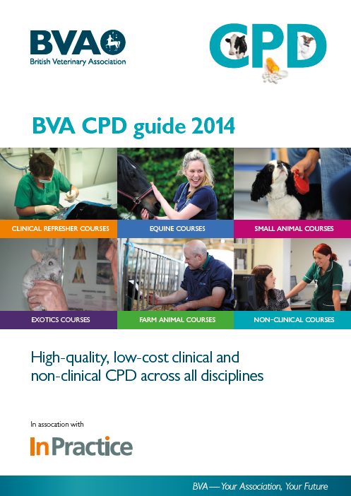

Slide 17
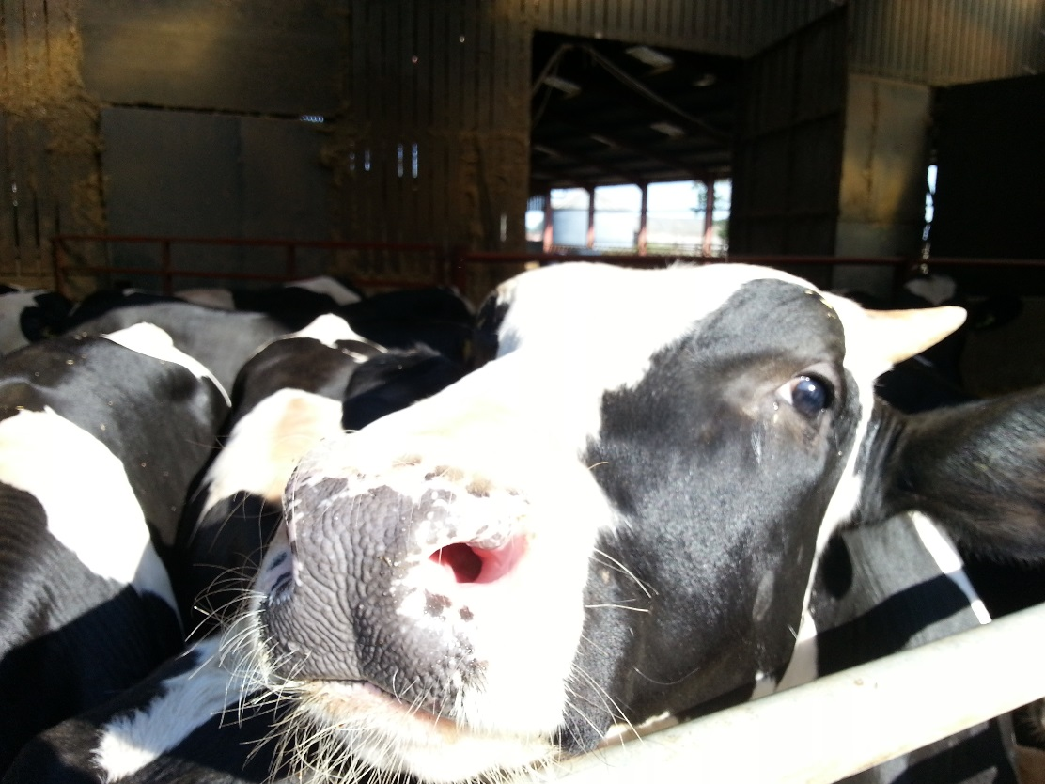
What more do we need to do?
Need to further scrutinise our methods of using antimicrobials and minimise our reliance on them
Every vet must be made aware of the problem
  training, education, guidelines: NO EXCUSE FOR INACTION
Every vet should be held accountable for which antimicrobial used
  RCVS New Code of Professional Conduct
  Clinical governance, health protocols
While it’s recognised that there is over-use in the medical sector, we must also play our part, and be seen to do so

Slide 18
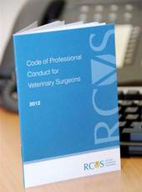
How can the veterinary profession regulate the use of antimicrobials?
Through the RCVS Code of Professional Conduct;
1. Veterinary surgeons and animals
1.5 Veterinary surgeons who prescribe,
supply and administer medicines must
do so responsibly.

Slide 19
Code of Professional Conduct
- supporting guidance
Section 4.22
The development and spread of antimicrobial resistance is a global public health problem that is affected by use of these medicinal products in both humans and animals.
Veterinary surgeons must be seen to ensure that when using antimicrobials they do so responsibly, and be accountable for the choices made in such use.

Slide 20
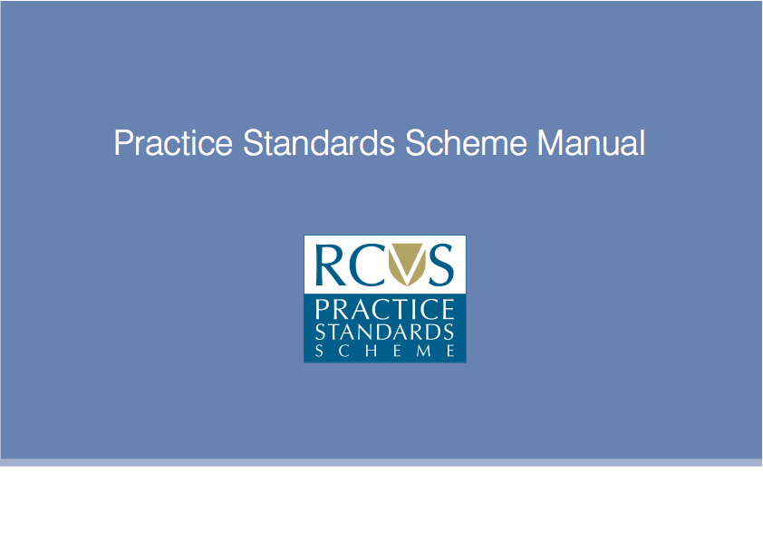
Ensure compliance through the Practice Standards Scheme (PSS)
All practices must comply with the core standards of the practice standards scheme
Inspectors will be assessing practices’ compliance with responsible used guidelines and for practices not in PSS, VMD inspectors will be checking for adherence to responsible use guidelines
RCVS has amended the current PSS manual to include the revision under section 8, Medicines, which reads: A practice must be able to demonstrate that when using antimicrobials or anthelmintics, it does so responsibly and is accountable for the choices made in such use

Slide 21
What more do we need?
developing new drugs, treatments and diagnostics through better collaboration between research councils, academia, industry and others; and by encouraging greater public-private investment in the discovery and development of a sustainable supply of effective new antimicrobials, rapid diagnostics, and complementary tools for use in health, social care, and veterinary systems (supports Strategic aims ii and iii)
Key strategic aim (4) UK AMR strategy 2013-2018

Slide 22
And …
better access to and use of surveillance data in human and animal sectors through new arrangements that facilitate greater consistency and standardisation of the data collected across the system and encourage improved data linkage (supports strategic aims i and ii), (key strategic aim 5)

Slide 23
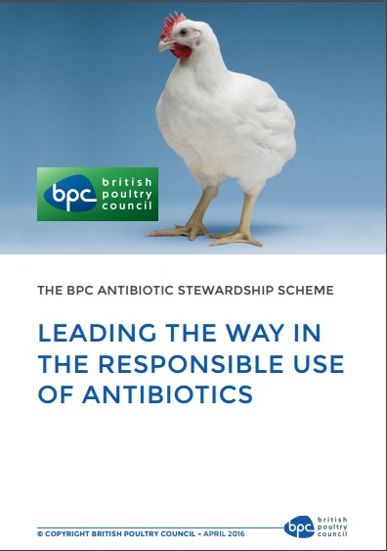
BPC - Robust Data Collection- 90% of production
From 2012-15:
- 5% increased production
44% total UK Meat Production
44% decrease in total antibiotic use
From 2014-15:
- 48% reduction in use of FQ’s
96% reduction in Chicken
36% reduction in Turkey

Slide 24
Country | Antimicrobial sales (tonnes) | Animal Biomass (x 103 tonnes) | Antimicrobial Use PCU mg/Kg
Denmark | 107 | 2424 | 44.1
Germany | 1707.5 | 8,338 | 204.8
New Zealand | 58.9 | 6279 | 9.4
USA | 14,618 | 54909 | 266.2
UK | 862.3 | 6749 | 66.3
Netherlands | 245.7 | 3279 | 74.9
Norway | 7.1 | 1851 | 3.8

Slide 25
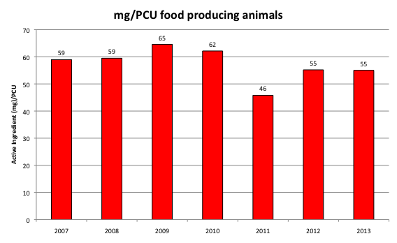
Use of total antibiotics in veterinary medicine in the UK
mg/PCU: mg per population corrected unit – estimated sales corrected by animal population. 1 PCU = 1kg of different categories of livestock
Data supplied by VMD June 2014; 2013 data still undergoing validation and subject to change
.

Slide 26
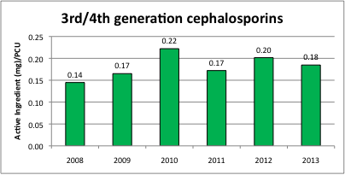
Use of 3rd/4th generation cephalosporins in veterinary medicine in UK
mg/PCU: mg per population corrected unit – estimated sales corrected by animal population. 1 PCU =!kg of different categories of livestock
Data supplied by VMD June 2014

Slide 27
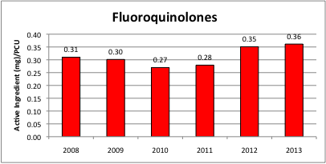
Use of fluoroquinolones in veterinary medicine in UK
mg/PCU: mg per population corrected unit – estimated sales corrected by animal population. 1 PCU =!kg of different categories of livestock
Data supplied by VMD June 2014

Slide 28
Key messages
The message is clear…if the veterinary profession doesn’t change, change will be imposed
Veterinary antibiotic use in the future will be different
Accept that we need constraints on certain classes of antimicrobial and on how and when we use them to auditable protocols
Work the One Health concept vigorously, - build alliances
Education education education
Grow the relationships with others in the animal health community
Positive communications/media/PR is critically important

Slide 29
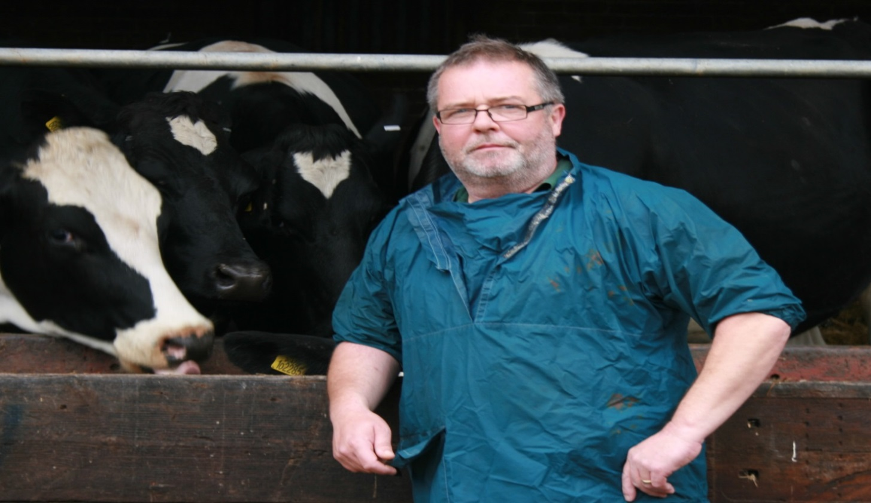

Thanks for listening

