Slide 1
Taxation and Health
David McCoy and Simukai Chigudu

Slide 2
A brief history of taxation…
Tax can be traced back to the earliest days of human civilisation
As small subsistence communities transformed into larger and more complex societies, social and economic organisation through the development of forms of centralised ‘authority’ became increasingly necessary
The imposition of tax was one way of both expressing and sustaining this authority, and has been central to the development of the modern state
The transition from domain states (in which government activities were funded from surpluses derived from the monarchy’s own properties) to tax states (in which the state earned its revenue by taxing its citizens) also introduced a new political dynamic

Slide 3
Tax and State Formation: Global North
Prichard’s 3 interconnected processes of tax and good governance:
‘Common Interest’ processes
  governments become dependent on tax revenue and are thereby incentivised to promote economic growth and prosperity of citizens
‘State Apparatus’ processes
  tax administration has the effect of developing a public bureaucracy including mechanisms for population data collection which facilitates public sector planning and resource allocation
‘Accountability and Responsiveness’ processes
  taxation empowers citizens to make claims of government, legitimises civil society engagement and participation in political decision-making, and can improve social cohesion as different social groups form alliances to bargain with the state in pursuit of the ‘common good’

Slide 4
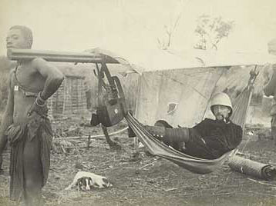
Tax and State Formation: Global South
The ‘European commandant is not posted to observe nature... He has a mission... to impose regulations, to limit individual liberties.... to collect taxes’ (Young, 1994)
Colonialism
  Subjugation
  Expropriation
Post-colonialism
  Inherited state-society disconnect
  Poor state infrastructure
Globalisation
  Globalised markets
  Creation of rentier states

Slide 5
Political Pathologies of Natural Wealth (Moore)
Autonomy from citizens – a ‘guaranteed’ income makes the state independent of its citizens; little incentive to listen to citizens or grant them democratic influence.
External intervention – strategic commodities, such as oil, continually motivate political and military intervention by the rich nations
Coupism and countercoupism – politics becomes increasingly militarised where rival factions seek secure access to valuable commodities
Absence of incentives for civic politics – the absence of tax systems discourages citizens from bargaining with the state to ensure appropriate use of collective resources.
Vulnerability to subversion – failing to tax the bulk of citizens, leaves them out of the ambit of civilian bureaucracy and more prone to insurgency.
Non-transparency in public expenditure – revenue and expenditure are often hidden from view when public income is raised from relatively few sources.
Ineffective public bureaucracy – raising revenue from a few distinct sources requires only a small bureaucracy, leaving much public administration under-financed while resources are instead directed towards military and intelligence apparatuses.

Slide 6
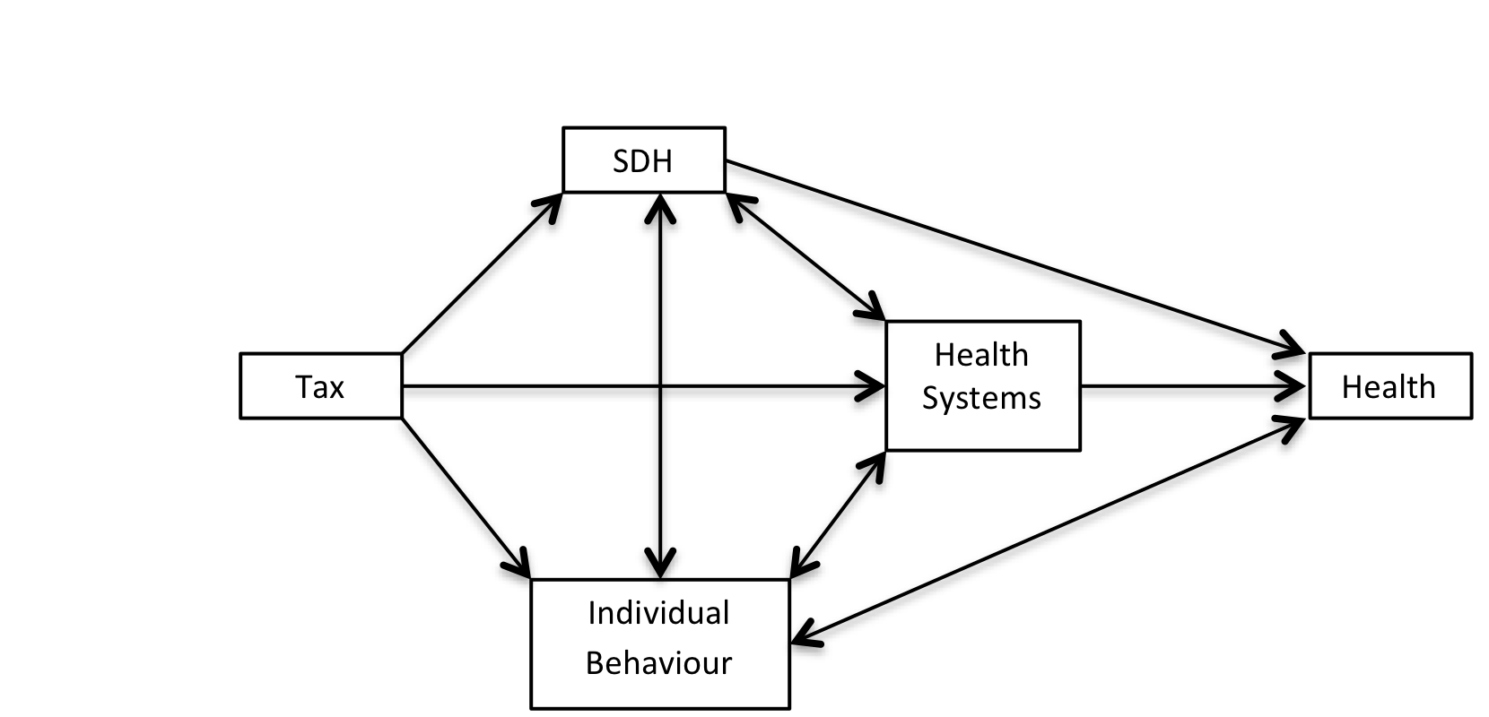
Tax and Health
Five functions of Tax
Representation
Redistribution
Revenue
Re-pricing
Regulation

Slide 7
Representation
State-society relationship
‘Good’ tax systems – Prichard’s processes
  ‘good health systems governance’

Slide 8
Redistribution
Reducing income inequality and social stratification
  Structural driver of:
    Violent crime
    Reduced social mobility
    Poor educational attainment
    Premature mortality & morbidity
Notes:
"The disposition to admire, and almost to worship, the rich and the powerful, and to despise, or, at least, to neglect persons of poor and mean condition is the great and most universal cause of the corruption of our moral sentiments.” Adam Smith (1723-1790)

Slide 9
Revenue generation
Health systems financing
SDH

Slide 10
Re-pricing
Inducing healthy behaviour without creating economic distortions
Special attention to ‘sin taxes’ – tobacco, alcohol, unhealthy foods
Create a ‘win-win-win’ situation:
  Decrease harmful consumption and improve public health
  Increase government revenues
  Reduce need for expensive treatments in the future

Slide 11
Regulation
Illicit trade
Financial transactions – ‘Tobin’ Tax
Bank tax
Global research tax
Illicit Financial Flows

Slide 12
% GDP Captured as Public Revenue
Country Category | Average Tax Revenue (% of GDP)
Low income countries | 13.0
Low middle income countries | 17.7
Upper middle income countries | 20.7
High income countries/OECD countries | 35.4

Slide 13
Why?
Ineffective and inefficient tax administrations
Large informal economy
  Larger proportion of tax income in poor countries comes from taxes on goods and services compared to richer countries which are better equipped to tax income, business profits and capital gains
  One study of 145 countries in 2003 found that the “shadow economy” made up 41.2% and 41.5% of GDP in Africa and Latin America respectively, while it was 16.8% in OECD countries

Slide 14
Why?
Trade liberalisation and reduction / removal of import and export duties
  Share of customs revenues to total state revenues in poor countries shrunk from 22% to 16%, and from 13% to 7% in middle-income countries between 1995 and 2003
  Supposed to have been compensated for by economic growth and increases in VAT. Study by the IMF showed that low-income countries were only able to compensate for about 30% of revenue losses through trade liberalisation
  Emran and Stiglitz argue that in countries with large informal economies, substituting trade taxes with VAT results in negative welfare effects
  Increased global mobility of finance and productive capacity has led to ‘tax competition’ between countries to attract foreign direct investment (FDI).
    Measures include tax holidays, duty-free export and import, free repatriation of profits, and exemptions from environmental safety and labour laws (often in designated EPZs where goods are landed, handled, manufactured and re-exported without the intervention of customs authorities)

Slide 15
Why?
Multinational enterprises (MNEs) and the widespread use of ‘transfer mispricing’ to shift profits from high to low tax jurisdictions.
  MNEs also use aggressive financial structures and schemes, supported by powerful firms of accountants and lawyers, to avoid or minimise legitimate tax payments
  Compounded by the role of tax havens

Slide 16
Tax Havens
Real or virtual jurisdictions, which offer low or zero taxation and a secrecy regime sustained either through banking secrecy laws or de facto judicial arrangements and banking practices.
Secrecy also creates an interface between licit and illicit economies, and promotes corruption and criminality by enabling the laundering of proceeds from a wide range of illegal activities

Slide 17
Illicit Financial Flows
Because of the secrecy, data on the shifting of wealth and assets to tax havens are not fully available.
One estimate is that IFFs out of developing countries between 2002 and 2006 amounted to between $850 billion to $1 trillion a year (Kar & Cartwright-Smith 2008).
  This estimate does not include trade mispricing or mispriced asset swaps
The African Union estimated that $148 billion a year (approximately a quarter of the continent’s GDP) leaves the continent because of corruption, aided and abetted by tax havens (Jackson 2006).

Slide 18
Illicit Financial Flows
Another study of 139 mainly low and middle income countries estimated that as of 2010, between $21 and $32 trillion have been invested virtually tax-free through more than 80 offshore jurisdictions, of which $7.3 to $9.3 trillion of this unrecorded offshore wealth is accounted for by individual private elites (Henry 2012).
  These figures exclude non-financial wealth in the form of real estate, yachts, racehorses, gold bricks as well as net claims on ‘intangibles’ like intellectual property.
If that global offshore financial wealth of $21 trillion earns a total return of 3% a year, this would generate annual revenues of $189 billion per year
  more than twice the $86 billion that OECD countries as a whole spend on overseas development assistance.

Slide 19
Make Tax a Multi-Faceted Public Health Issue?

