Slide 1
Global Economic Governance for Health: the Moral Imperative of Democratisation
David Woodward
Medact Relaunch
London, 9 November 2013

Slide 2
Distinguish between….
Global health governance
  Global governance with respect to factors primarily affecting health
  Focus on health systems/sectors, medical interventions, health sector inputs, cross-border transmission of disease
  Centred on health-specific institutions (WHO)
Global governance for health
  Ensuring that global governance as a whole protects and promotes health

Slide 3
Global Economic Governance for Health
Steering the global economy in such a way as to benefit health (broadly defined)
Primarily in relation to
  Trade (WTO, regional/bilateral agreements)
  Finance, debt, etc (IMF, Paris Club, BIS….)
  Development policy/finance (esp. World Bank, regional development banks, DAC)
  Overall direction/corrdination (G7/8, G20, etc)
  Filling gaps (TNCs, taxation, etc)
Focus here on IMF

Slide 4
The Need for Democratisation
“It is only through such a system of global governance, placing fairness in health at the heart of the development agenda, and genuine equality of influence at the heart of its decision-making, that coherent attention to health equity is possible.”
Commission on Social Determinants of Health, 2008

Slide 5
“in the terrible history of famines in the world, no substantial famine has ever occurred in any independent and democratic country with a relatively free press. We cannot find exceptions to this rule, no matter where we look….
When things go fine and everything is routinely good, this instrumental role of democracy may not be particularly missed. It is when things get fouled up, for one reason or another, that the political incentives provided by democratic governance acquire great practical value.”
Amartya Sen, Democracy as a Universal Value, 1999

Slide 6
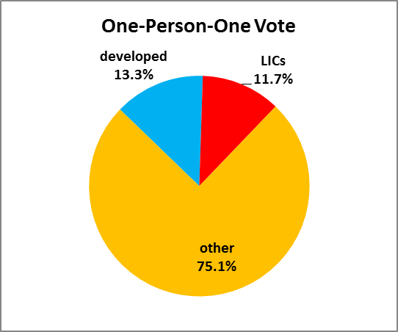
IMF Votes: Developed Countries cf Low-Income Countries

Slide 7
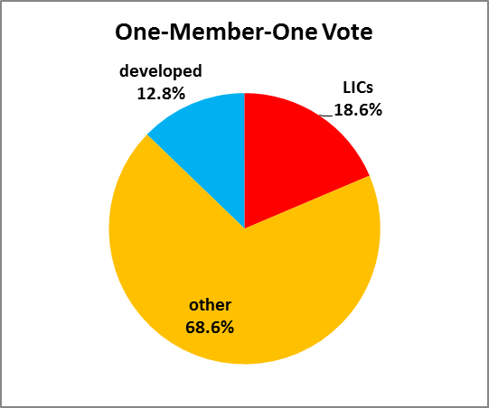
IMF Votes: Developed Countries cf Low-Income Countries

Slide 8
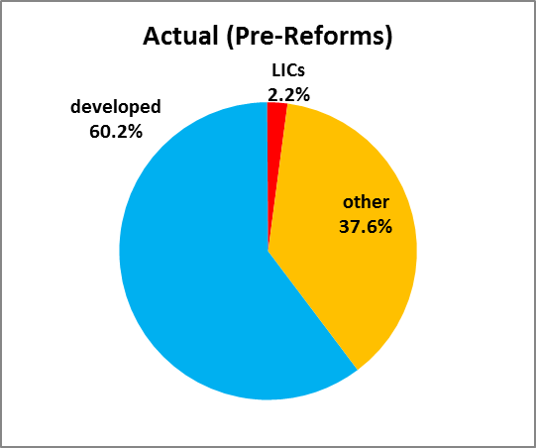
IMF Votes: Developed Countries cf Low-Income Countries

Slide 9
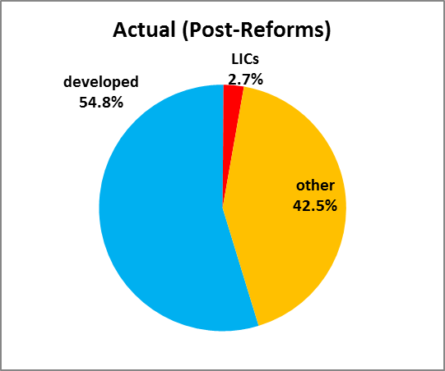
IMF Votes: Developed Countries cf Low-Income Countries

Slide 10
Indirect Mechanisms
Direct effects of unequal voting power are compounded by
  the constituency system and Board representation
  asymmetry of accountability between appointed and “elected” Directors
  large constituencies and Directors’ workloads
  potential for coordination
  56% of LIC governments and 2 of the 3 low-income country Directors “felt they can freely criticize staff ‘rarely’ or ‘only on some issues’.” (IEO, 2008)

Slide 11
IMF Independent Evaluation Office Evaluation of IMF Governance (2008)
Didn’t consider the weighted voting system
Found the IMF was “effective” in making decisions in crisis situations….
  ….but didn’t consider crisis prevention - or the appropriateness of decisions(!)
“When a crisis is detected, alternative mechanisms for strategy formulation, decision making, and implementation are super-imposed over the usual mechanisms. The crisis mechanisms center on a small network of senior government officials — generally from the countries most closely involved (often the G-7 deputies).”
  Pre-reform, G7 Directors alone controlled 45.1% of votes in the Executive Board – now 41.2%
  NB IEO was headed by a former Canadian ED (a G7 member)

Slide 12
Manifestations
Skews decision-making towards developed country and creditor interests
  very slow response to debt crisis (especially for low-income countries)
  “voluntary” approach to commercial debt relief
  Asian crisis fiasco
  shortcomings of adjustment
  HIPC/PRSP design flaws
  skewed priorities – eg money laundering post-9/11

Slide 13
An Example: Compare and Contrast….
Greece
  within two years, 70-75% cancellation available on €200bn of commercial debts
Sub-Saharan Africa (crisis began 1976-82)
  1988: first (limited) cancellation of debt-service payments to government creditors
  1989: WB-funded debt buy-backs on commercial debts
  1994: stock-of-debt cancellation on government debt
  1996: multilateral debt cancellation available – but built-in delay of six years+
  end-2004, only 7 of 42 eligible countries had qualified

Slide 14
What Went Wrong?
  No independent mechanism for debt resolution
    IMF is a creditor, controlled by other creditors
  Financial abdication
    All debt relief voluntary: IMF could have enforced, but didn’t
    Always (and clearly) too little too late
    → degree of austerity dictated by willingness of creditors
  Policy cooption – IMF as enforcer
    All financing and debt relief subject to policy conditionality
    Austerity
      politically untenable, economically damaging, socially harmful
    Structural adjustment
      driven by neoliberal ideology, economically ineffective (at best)
  Financial dependency used as a policy lever
  All reflect the interests of the developed countries

Slide 15
Commission on Social Determinants of Health on Structural Adjustment
“structural adjustment… had a severe adverse impact on key social determinants of health – including health care and education – across most participating countries”
the IMF’s “overall policies and targets… limit the resources available for health care and health personnel, and health ministries have difficulty influencing the budget-setting process”
“it is not clear that the harsh degree and policy strait-jacket that structural adjustment imposed produced the anticipated benefits, much less whether the health and social costs were warranted”

Slide 16
SSA: Annual Change in Life Expectancy, 1960-2010 (years)

Slide 17
SSA: Annual Change in Life Expectancy, 1960-2010 (years)
Balance of payment
problems emerge, 1976ff

Slide 18
SSA: Annual % Change in Under-5 Mortality, 1965-2010

Slide 19
HIV/AIDS?
Too much, too soon

Slide 20
SSA: Change in Life Expectancy, 1960-2010

Slide 21
SSA Change in Life Expectancy
(adjusted for HIV/AIDS)

Slide 22
SSA: Annual % Change in Under-5 Mortality, 1965-2010

Slide 23
SSA % Change in u5MR
(adjusted for HIV/AIDS)

Slide 24
Extreme Poverty in SSA, 1981-2008
PRSP approach, 1999

Slide 25
Average Incomes of Poor Households, SSA, 1981-2005

Slide 26
HIV/AIDS?
Too much, too soon
HIV is not independent of debt/adjustment
  Poverty + responses
  Nutrition
  Health systems….
Other powerful confouding factors operating in the opposite direction in the 1980s
  Primary health care
  Mass vaccination campaigns
  Oral reydration therapy
  Should have seen a major acceleration in health improvement (esp. u5MR)

Slide 27
“The Rise of the South”?
Rise of “BRICS” and “emerging markets”
Shifting overall North-South balance, BUT….
  Benefits to emerging markets relatively limited – influence remains much less than population share
  Northern minority still dominates
  Doesn’t benefit LICs

Slide 28
IMF Votes: Developed Countries cf Low-Income Countries

Slide 29
“The Rise of the South”?
Rise of “BRICS” and “emerging markets”
Shifting overall North-South balance, BUT….
  Benefits to emerging markets relatively limited – influence remains much less than population share
  Northern minority still dominates
  Doesn’t benefit LICs
  Different interests from LICs/LDCs
  Gap widens further as they get richer
  Impasse: emerging markets strong enough to block, but not to set agenda – eg WTO; climate
No substitute for democracy!

Slide 30
Conclusions
The democratic deficit in global governance skews decision-making away from the interests of the poor majority
As the SSA debt crisis shows, this costs (a lot of) lives
  The health impact could have been limited had the debt crisis been handled differently
Democratising global economic governance is critical to global health.

Slide 31
“we deem it unjust when a national economic order is coercively imposed by a powerful minority and demand that any large majority of its participants should be able to change its rules without the use of force. But few in the wealthy countries would place the same moral requirement on the global economic order — most would dismiss it as ridiculous or absurd…. [W]e, the affluent countries and their citizens, continue to impose a global economic order under which millions avoidably die each year from poverty-related causes.”
Thomas Pogge, Moral Univeralism and Global Economic Justice, 2002

